Slide 1
Warm-Up
Write down 5 things you notice in this image.
I notice…
Notes:
This can be done independently, with a partner, or students can create individual lists and then share with a partner.

Slide 2
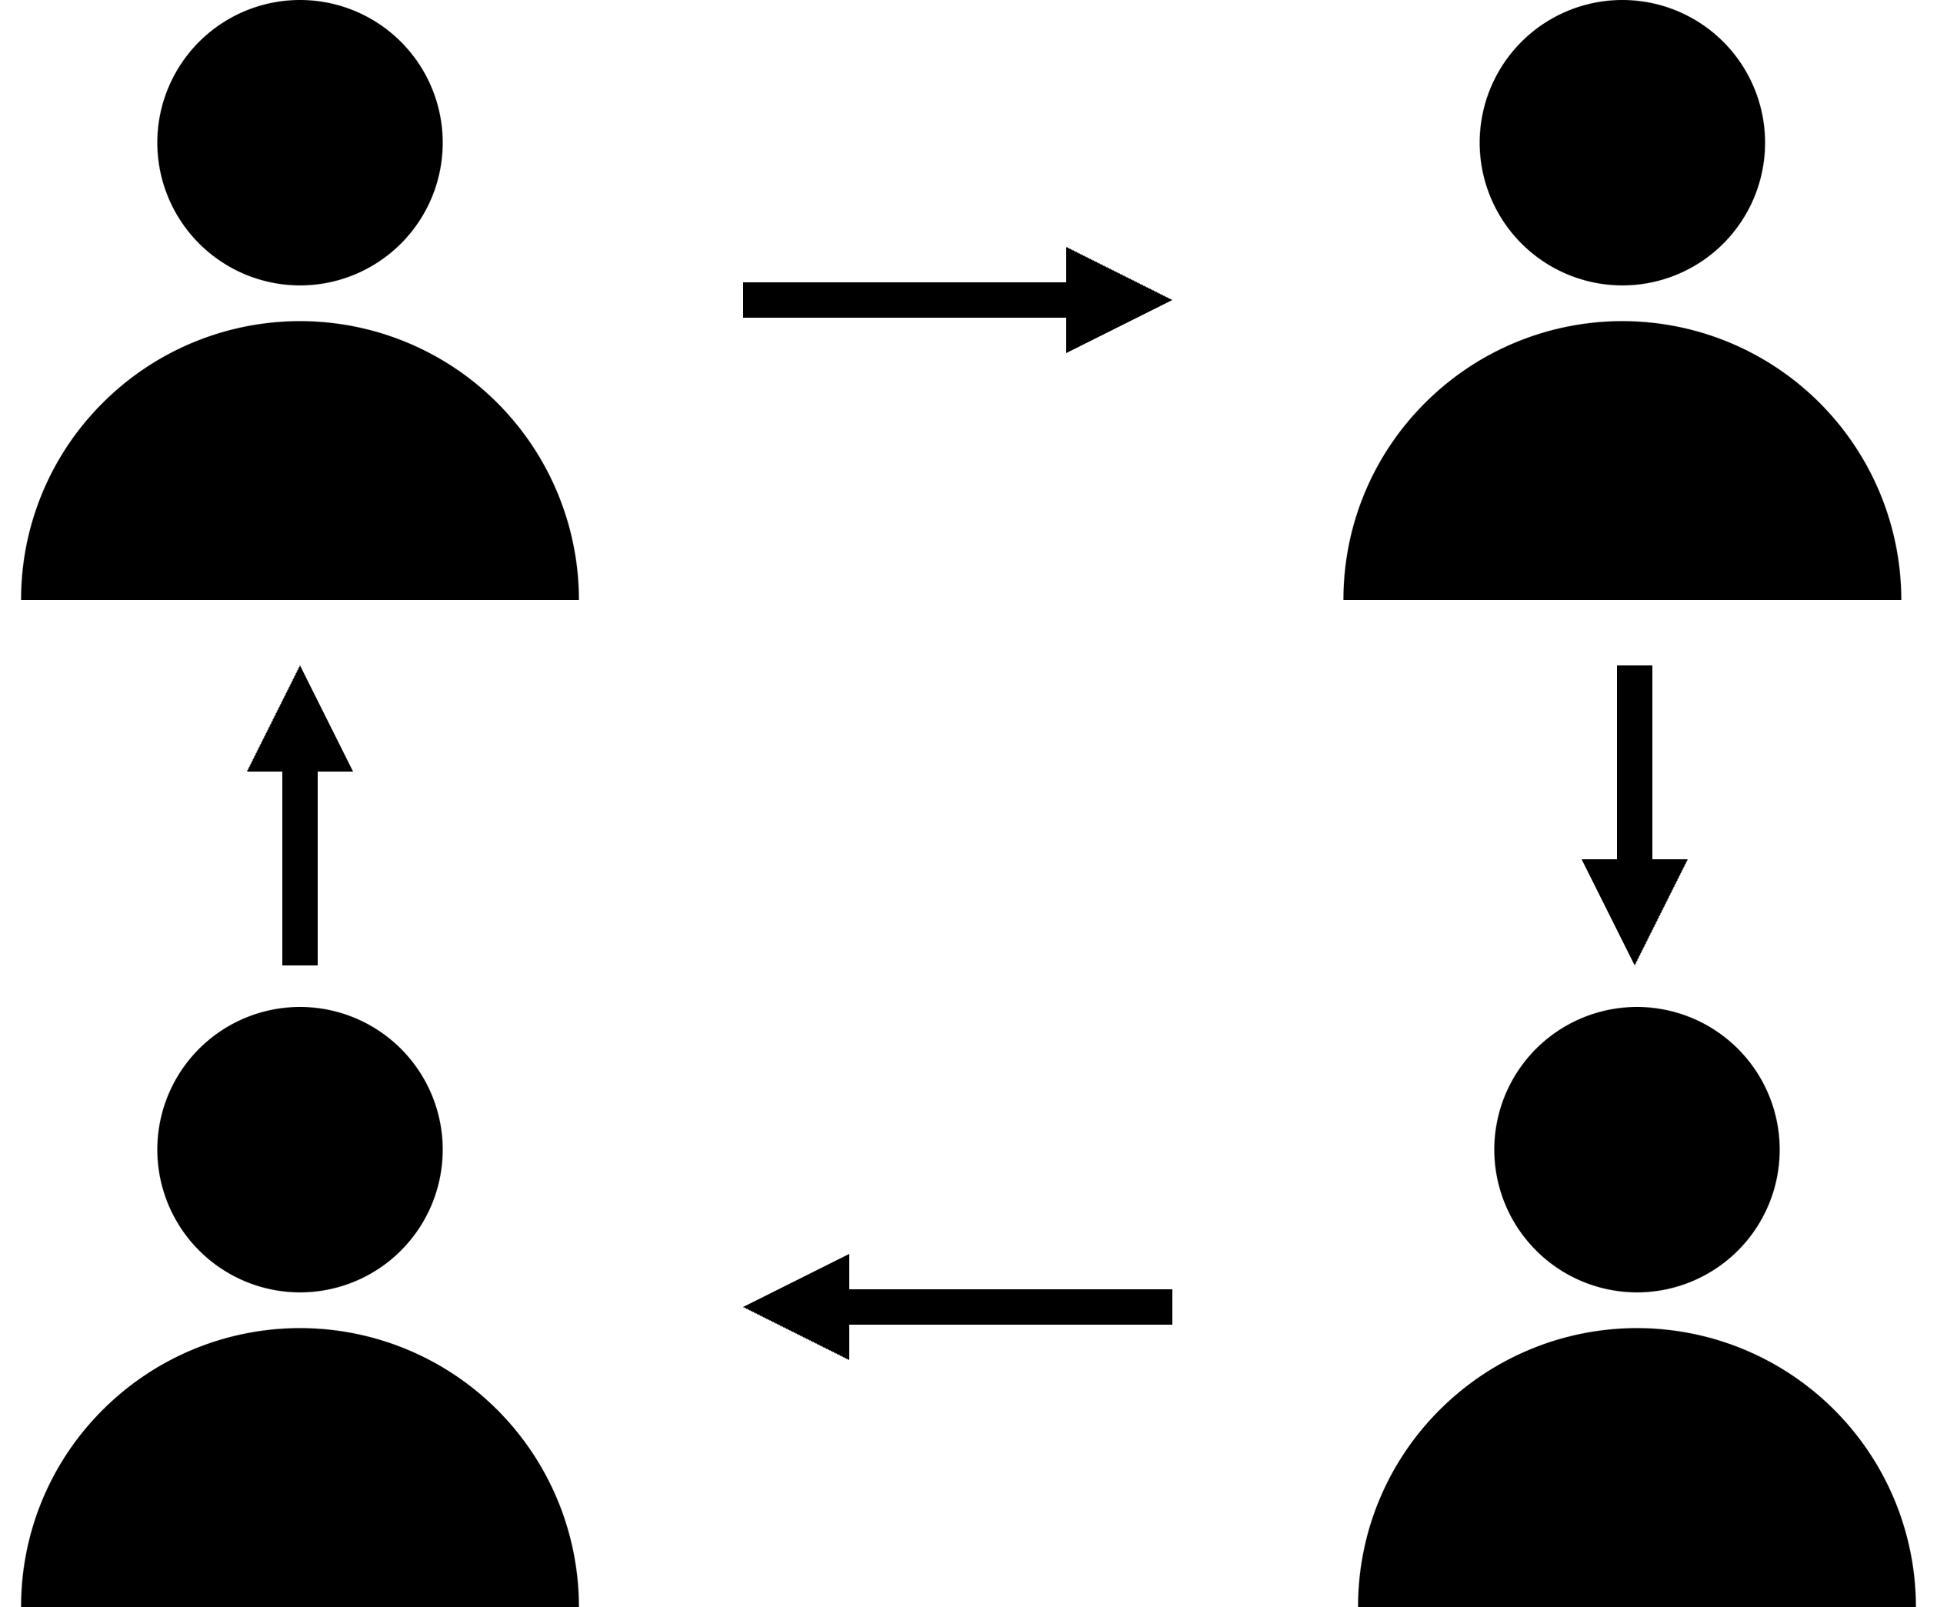
Observational Question
What is the purpose of a pupa?
The purpose of a pupa is...
Signal:
Share:
Goes 1ˢᵗ:
A
Assess:
Notes:
Script:
• Class, let’s pronounce this word out loud: (read vocabulary word out loud slowly). • Can everyone (raise a thumb/stand up/raise your hand/put your hand on your head)? Think about this question, when you are ready to answer this question, (lower your hand/sit down). • You are going to share with (shoulder partner/table group/away partner) The person in your group that will go first is the person (with the longest hair/with the shortest hair/with the brightest shirt/with the darkest shirt/[letter designation within the table group]/closest to the door/closest to the window). • [Students share with their partners/groups. When ~50% of the class is no longer discussing the content, bring everyone back together.] • I’m going to (call on some students randomly/call on one person with each group [perhaps using one of the “Goes 1ˢᵗ” designations]/have everyone write down their response).

Slide 3
Observational Question
What occurs during the process of metamorphosis?
During the process of metamorphosis, ...
Signal:
Share:
Goes 1ˢᵗ:
A
Assess:
Notes:
Script:
• Class, let’s pronounce this word out loud: (read vocabulary word out loud slowly). • Can everyone (raise a thumb/stand up/raise your hand/put your hand on your head)? Think about this question, when you are ready to answer this question, (lower your hand/sit down). • You are going to share with (shoulder partner/table group/away partner) The person in your group that will go first is the person (with the longest hair/with the shortest hair/with the brightest shirt/with the darkest shirt/[letter designation within the table group]/closest to the door/closest to the window). • [Students share with their partners/groups. When ~50% of the class is no longer discussing the content, bring everyone back together.] • I’m going to (call on some students randomly/call on one person with each group [perhaps using one of the “Goes 1ˢᵗ” designations]/have everyone write down their response).

Slide 4
Relational Question
How is a pupa important for metamorphosis?
A pupa is important for metamorphosis because...
Signal:
Share:
Goes 1ˢᵗ:
A
Assess:
Notes:
Script:
• Can everyone (raise a thumb/stand up/raise your hand/put your hand on your head)? Think about this question, when you are ready to answer this question, (lower your hand/sit down). • You are going to share with (shoulder partner/table group/away partner) The person in your group that will go first is the person (with the longest hair/with the shortest hair/with the brightest shirt/with the darkest shirt/[letter designation within the table group]/closest to the door/closest to the window). • [Students share with their partners/groups. When ~50% of the class is no longer discussing the content, bring everyone back together.] • I’m going to (call on some students randomly/call on one person with each group [perhaps using one of the “Goes 1ˢᵗ” designations]/have everyone write down their response).

Slide 5
Relational Question
How is a pupa important for metamorphosis?
A pupa is important for metamorphosis because...
Signal:
Share:
Goes 1ˢᵗ:
A
Assess:
Notes:
Script:
• Can everyone (raise a thumb/stand up/raise your hand/put your hand on your head)? Think about this question, when you are ready to answer this question, (lower your hand/sit down). • You are going to share with (shoulder partner/table group/away partner) The person in your group that will go first is the person (with the longest hair/with the shortest hair/with the brightest shirt/with the darkest shirt/[letter designation within the table group]/closest to the door/closest to the window). • [Students share with their partners/groups. When ~50% of the class is no longer discussing the content, bring everyone back together.] • I’m going to (call on some students randomly/call on one person with each group [perhaps using one of the “Goes 1ˢᵗ” designations]/have everyone write down their response).

Slide 6
Inferential Question
Why do you think it’s important for pupae to be strong and thick?
It is important for pupae to be strong and thick because...
Signal:
Share:
Goes 1ˢᵗ:
A
Assess:
Notes:
Script:
• Can everyone (raise a thumb/stand up/raise your hand/put your hand on your head)? Think about this question, when you are ready to answer this question, (lower your hand/sit down). • You are going to share with (shoulder partner/table group/away partner) The person in your group that will go first is the person (with the longest hair/with the shortest hair/with the brightest shirt/with the darkest shirt/[letter designation within the table group]/closest to the door/closest to the window). • [Students share with their partners/groups. When ~50% of the class is no longer discussing the content, bring everyone back together.] • I’m going to (call on some students randomly/call on one person with each group [perhaps using one of the “Goes 1ˢᵗ” designations]/have everyone write down their response).

Slide 7
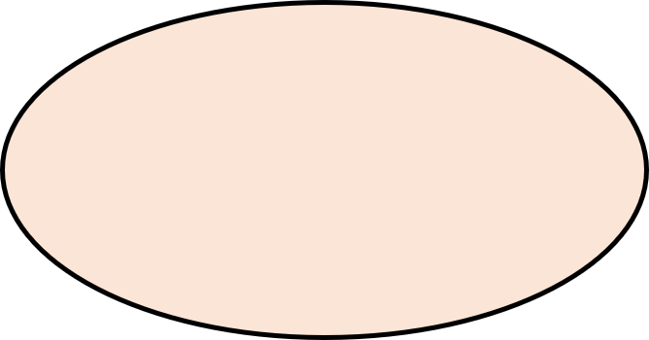
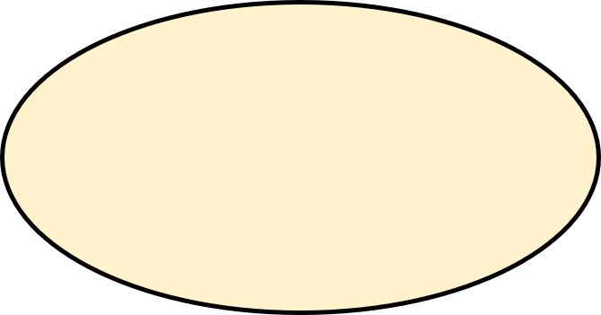
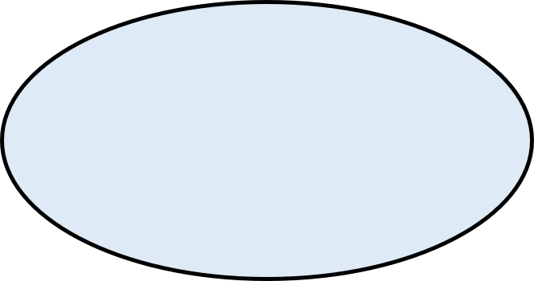
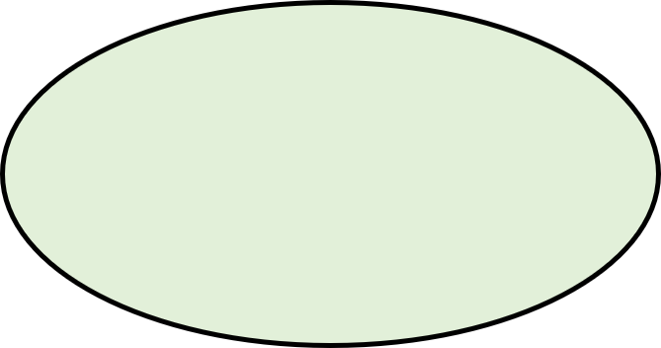
Extension
Make a word map connecting pupa to 3-5 other vocabulary words.
is related because…
is related because…
Next to each connecting line, describe how the two words are related.
Work with a partner or share your word map with a partner when you finish.
is related because…
is related because…
Copyright © 2022 Seidlitz Education, LLC.
Notes:
For example, if the central word is “atom”, a student might:
• Make a connection to “proton” and write “atoms contain protons” next to the connecting line. • Make a connection to “molecule” and write “atoms make up molecules” next to the connecting line. • Make a connection to “matter” and write “atoms are the smallest units of matter” next to the connecting line. • Make a connection to “nucleus” and write “the center of an atom is the nucleus” next to the connecting line. Alternatively, students can create a Vocab Connection Web (Teaching Science to English Learners by Fleenor and Beene, 2019, p.53) in which any connection can be made between any two words – there does not have a to a “central” word.

Slide 8
Extension
Write a paragraph describing pupa. Include 3-5 other vocabulary words in your paragraph.
Notes:
When students are finished, it is recommended that they share their paragraphs with a partner or group, with time afterwards to make any edits to their paragraphs.

