Slide 1



NOTE TO THE TEACHER
• This is YOUR lesson! Feel free to delete, change, or add any slides. • The purpose of these slides is to maximize verbal and written academic language from students. Depending on the length and other content of your lesson, some of the slides might not fit in with the content or the timing of the lesson. Each structured conversation should take 3-5 minutes, with the option of extending the conversation based on students’ responses. • It is recommended that some kind of objectives are displayed (such as in Slide 5), and that students interact with these objectives in some way (such as in Slide 6). • To customize each structured conversation, move the brackets to the appropriate icon.
Explanation on how to use these slides.
Disclaimer: As license holder of this product, you agree to that (1) you may use this digital product for your own use as an educator with your students and (2) you may not republish, reproduce, duplicate, copy, sell, display, or distribute to friends, colleagues, or any other third party. Any unauthorized use of the materials will constitute infringement of our rights.
Notes:
For the teacher, not to be displayed to students.

Slide 2







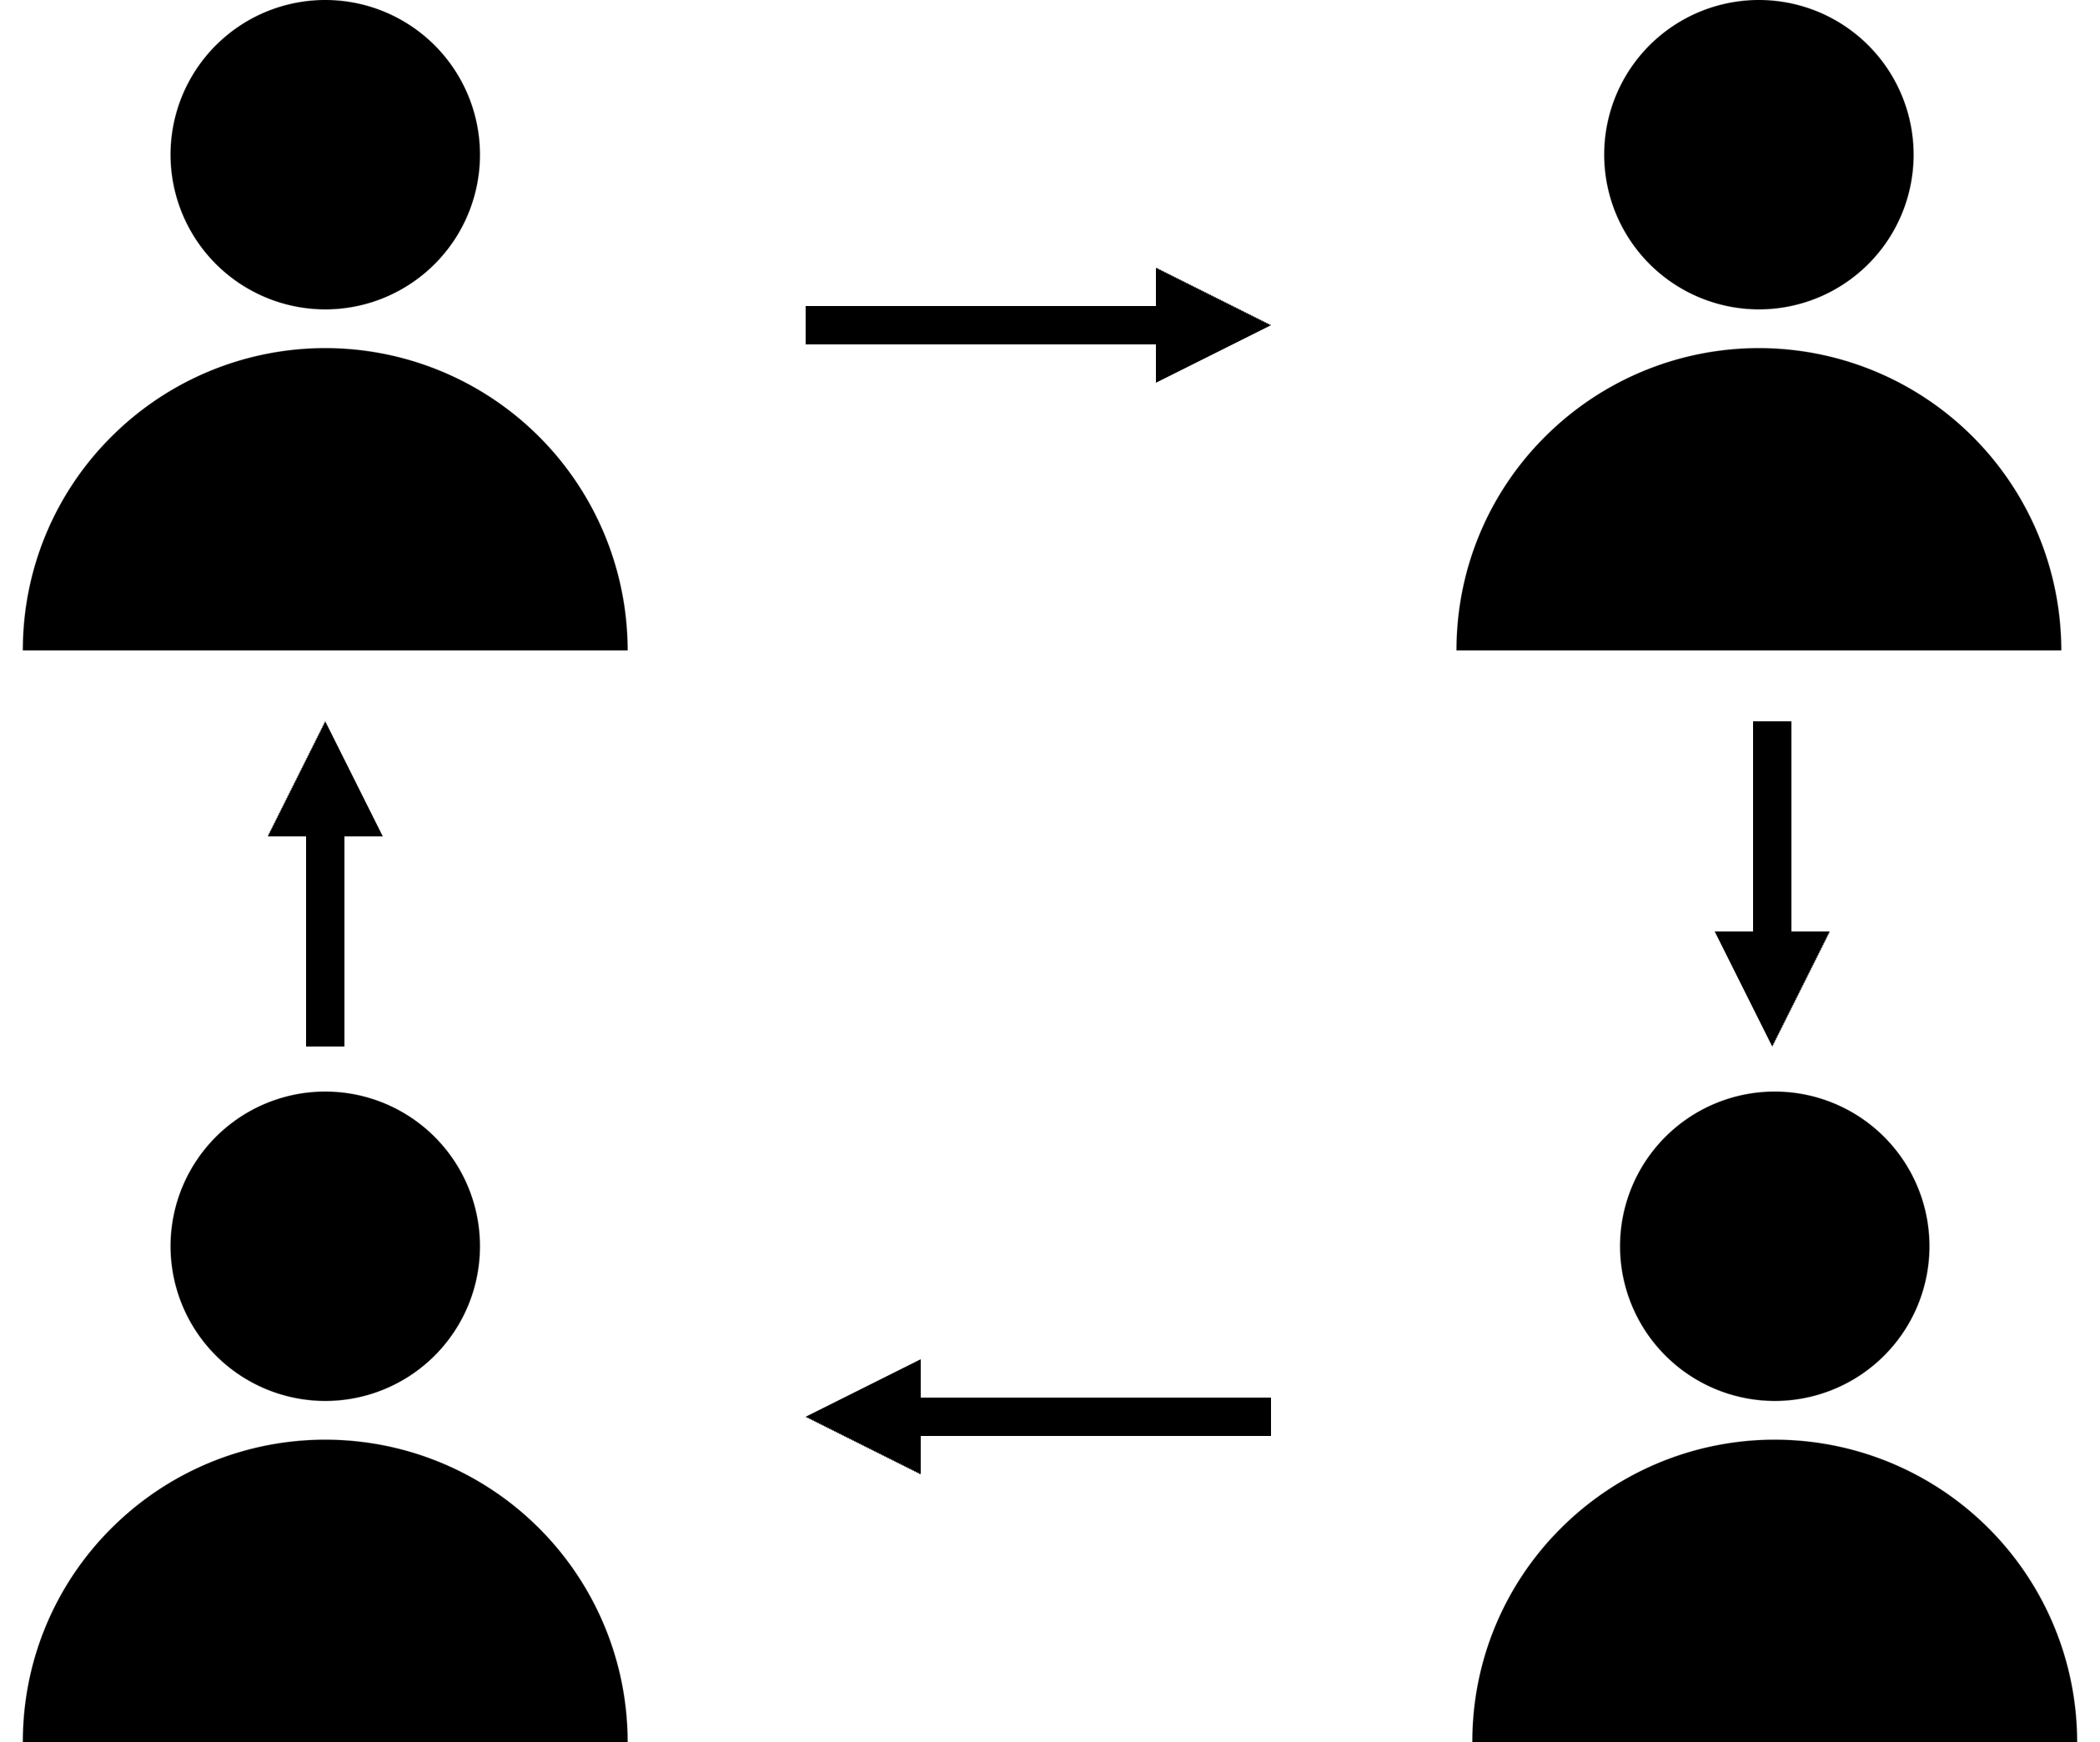







Guide to Icons
Signal:
Assess:
raise your thumb, lower when ready
stand up, sit down when ready
raise your hand, lower when ready
hand on head, lower when ready
randomly
one student from each group
all students write response
Share:
Goes 1ˢᵗ:
A
with shoulder partner or away partner
lightest shoe
darkest shoe
brightest shirt
darkest shirt
Student A (editable)
closest to door
closest to window
with table group
Notes:
For the teacher, not to be displayed to students.

Slide 3








Accommodations for Newcomers or Beginner Emergent Bilingual Students
Seat beginners next to students who follow instruction well, so they can model behavior during the structured conversations.
If sentence stems are complex,
encourage beginners to use these alternative stems:
Observational:
I notice… or [word] is…
Relational:
[word #1] is…, but [word #2] is…
Inferential:
I think [word]… or I predict [word]…
Have students echo new vocabulary words after you, pronouncing them together as a class. It’s even more effective for beginners if you break up each syllable while pointing to your mouth.
Have beginners participate in structured conversations, but make sure they’re ready before including them in the randomization pool to be called on whole-class.
Allow students to translanguage, or use multiple languages within a single sentence. Emphasize that they use the vocabulary word as it is presented, but otherwise encourage beginners to express themselves however they’re most comfortable.
Share the visuals and sentence stems with beginners the day before and have them write out their responses ahead of time.
Does your beginner read in Spanish? Try providing the Spanish visuals to your newcomer the day before.
Notes:
For the teacher, not to be displayed to students.
For a modelled example of supporting students to prepare them for randomization, see 7 Steps to a Language-Rich Interactive Classroom by John Seidlitz & Bill Perryman (p.17-18).

Slide 4
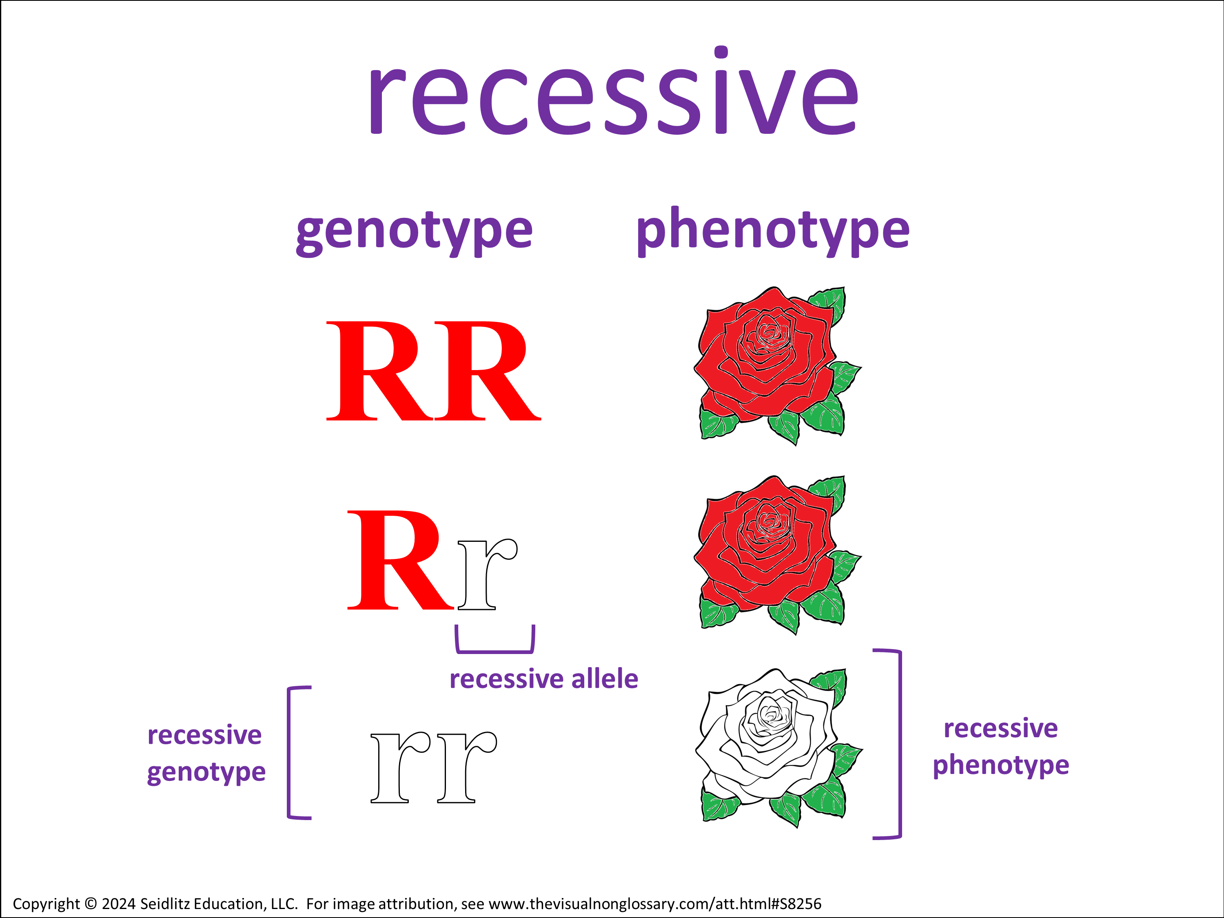



Warm-Up
5 things you notice in this image. I notice… 1 thing you wonder about in this image. I wonder…
Notes:
This can be done independently, with a partner, or students can create individual lists and then share with a partner.
ELPS
Listening:
2(C) learn new language structures, expressions, and basic and academic vocabulary heard during classroom instruction and interactions;
2(E) use visual, contextual, and linguistic support to enhance and confirm understanding of increasingly complex and elaborated spoken language;
2(I) demonstrate listening comprehension of increasingly complex spoken English by following directions, retelling or summarizing spoken messages, responding to questions and requests, collaborating with peers, and taking notes commensurate with content and grade-level needs.
Speaking:
3(A) practice producing sounds of newly acquired vocabulary such as long and short vowels, silent letters, and consonant clusters to pronounce English words in a manner that is increasingly comprehensible;
3(B) expand and internalize initial English vocabulary by learning and using high-frequency English words necessary for identifying and describing people, places, and objects, by retelling simple stories and basic information represented or supported by pictures, and by learning and using routine language needed for classroom communication;
3(D) speak using grade-level content area vocabulary in context to internalize new English words and build academic language proficiency;
3(E) share information in cooperative learning interactions;
3(G) express opinions, ideas, and feelings ranging from communicating single words and short phrases to participating in extended discussions on a variety of social and grade-appropriate academic topics;
3(J) respond orally to information presented in a wide variety of print, electronic, audio, and visual media to build and reinforce concept and language attainment.
Reading:
4(D) use prereading supports such as graphic organizers, illustrations, and pretaught topic-related vocabulary and other prereading activities to enhance comprehension of written text;
4(F) use visual and contextual support and support from peers and teachers to read grade-appropriate content area text, enhance and confirm understanding, and develop vocabulary, grasp of language structures, and background knowledge needed to comprehend increasingly challenging language;
Writing:
5(G) narrate, describe, and explain with increasing specificity and detail to fulfill content area writing needs as more English is acquired.
5(F) write using a variety of grade-appropriate sentence lengths, patterns, and connecting words to combine phrases, clauses, and sentences in increasingly accurate ways as more English is acquired; and
5(G) narrate, describe, and explain with increasing specificity and detail to fulfill content area writing needs as more English is acquired.

Slide 5
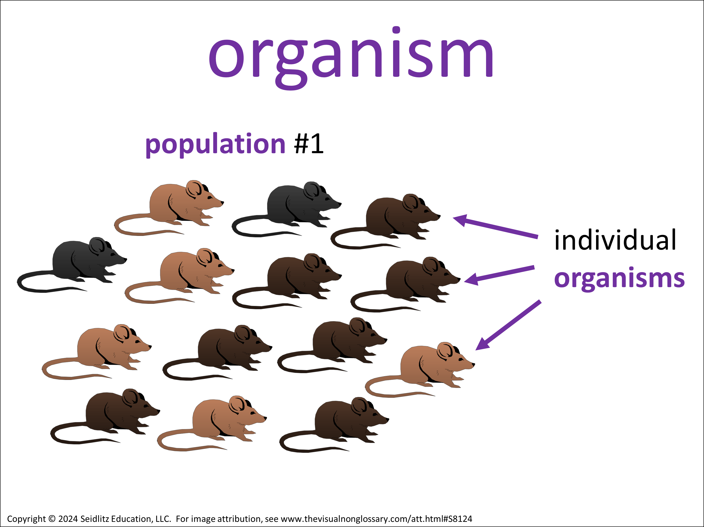
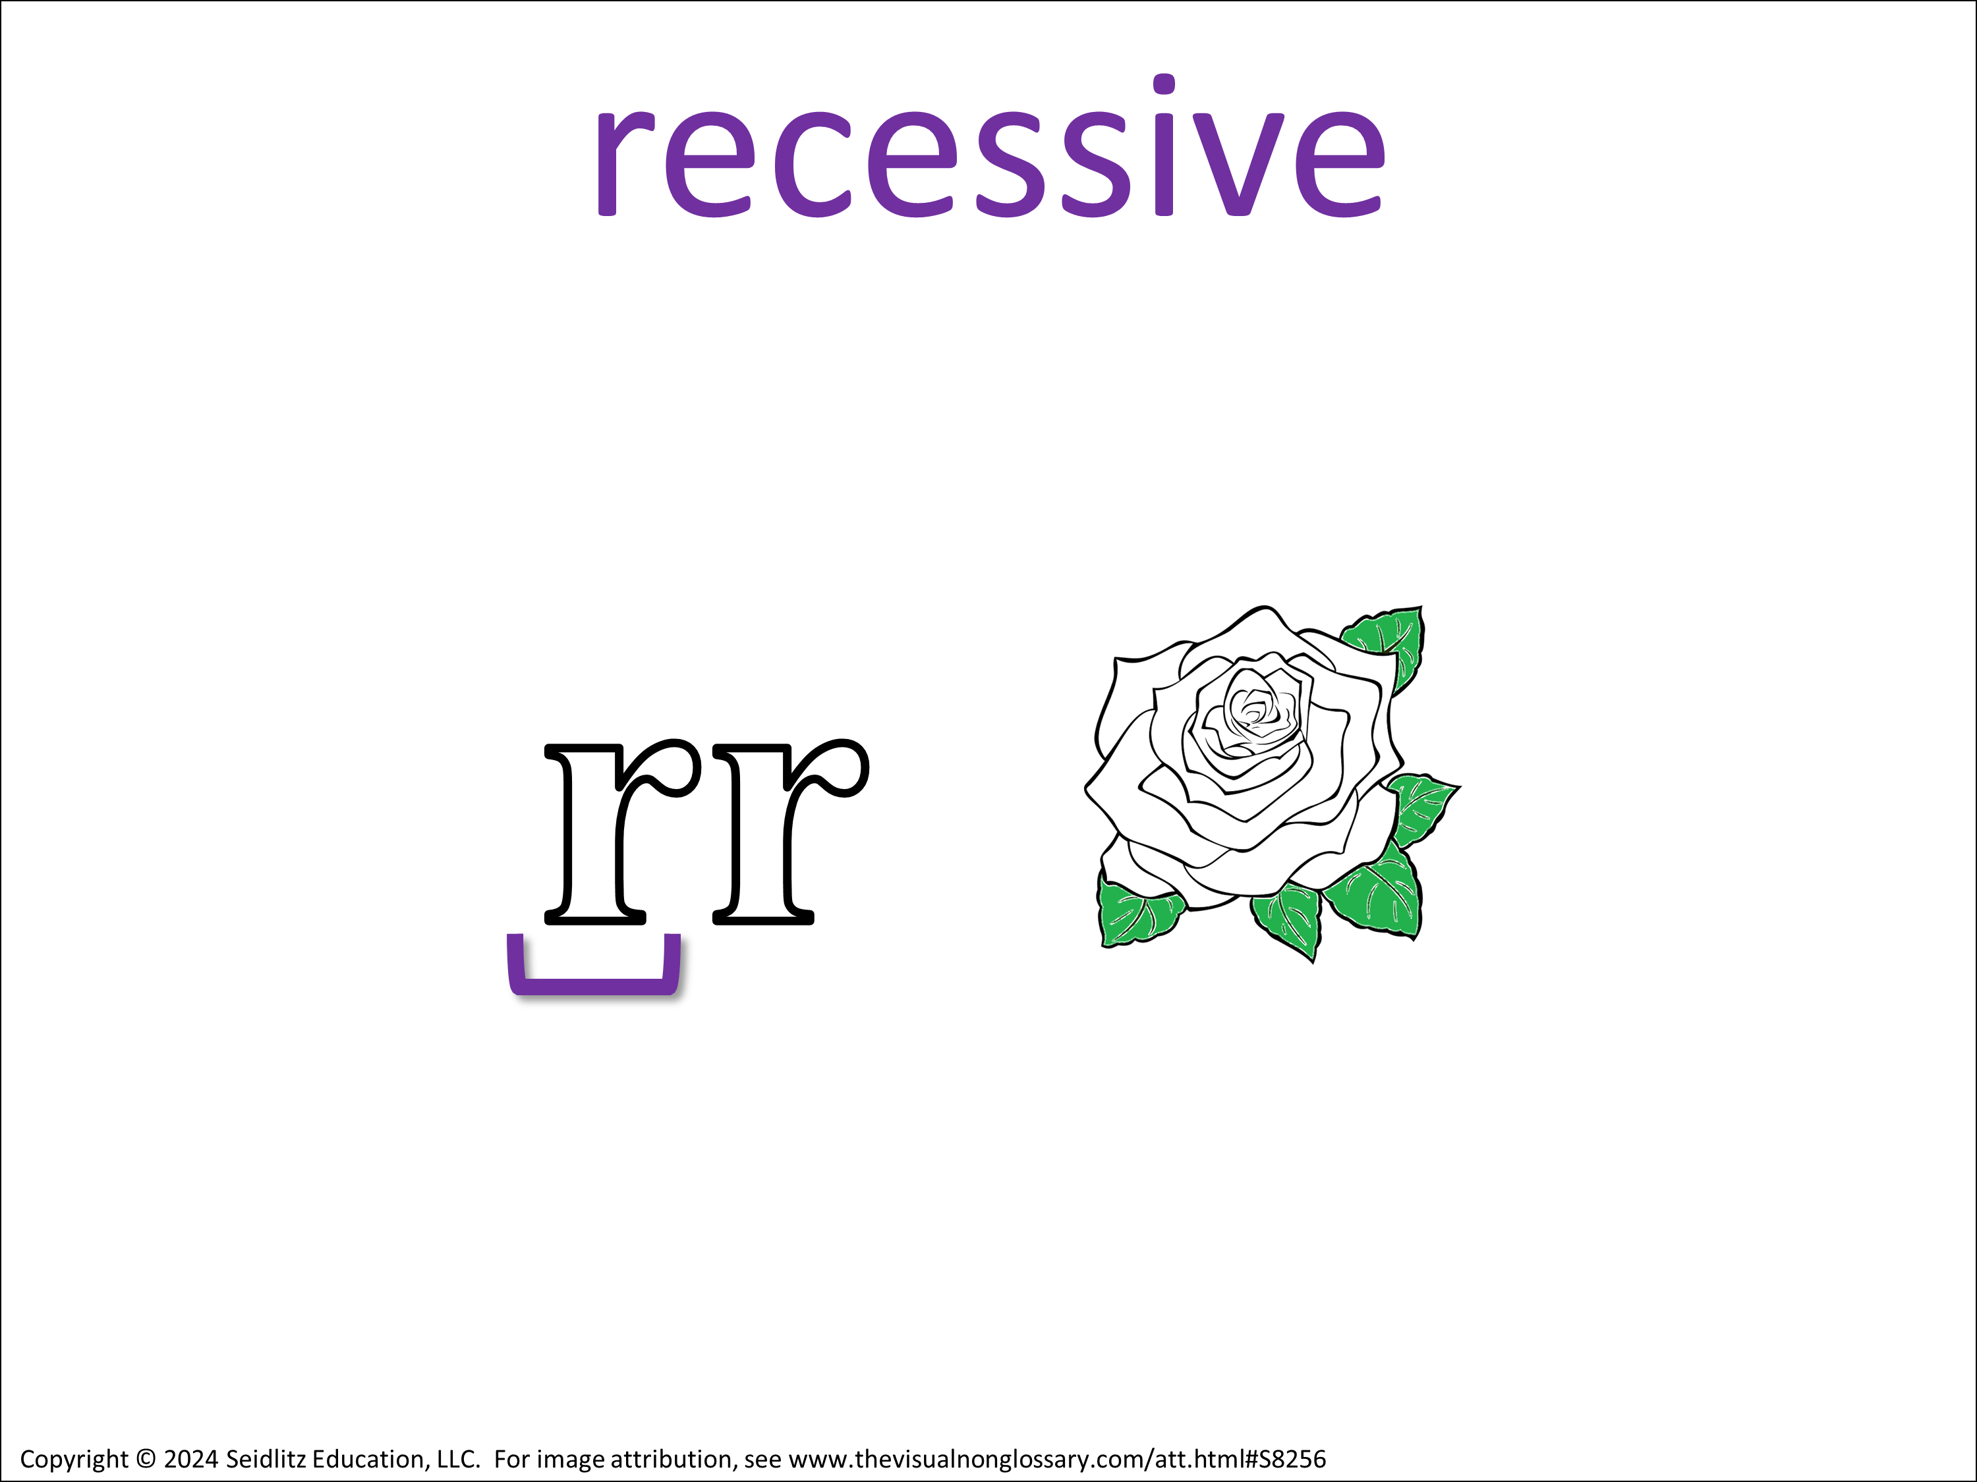
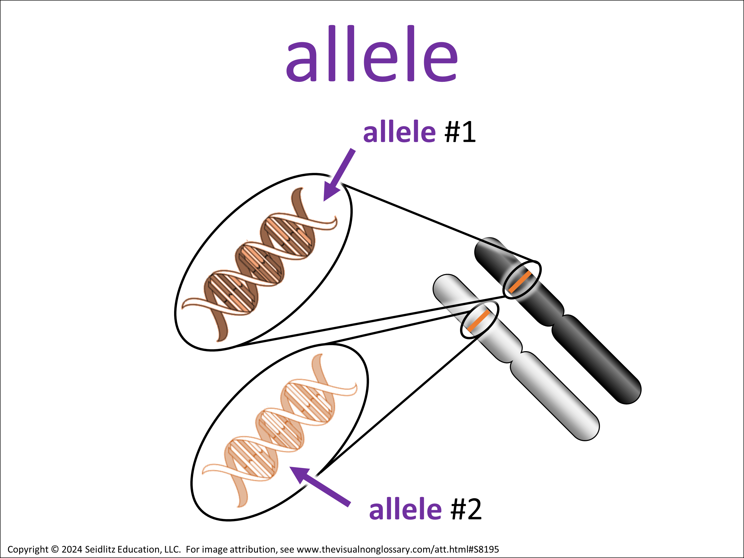

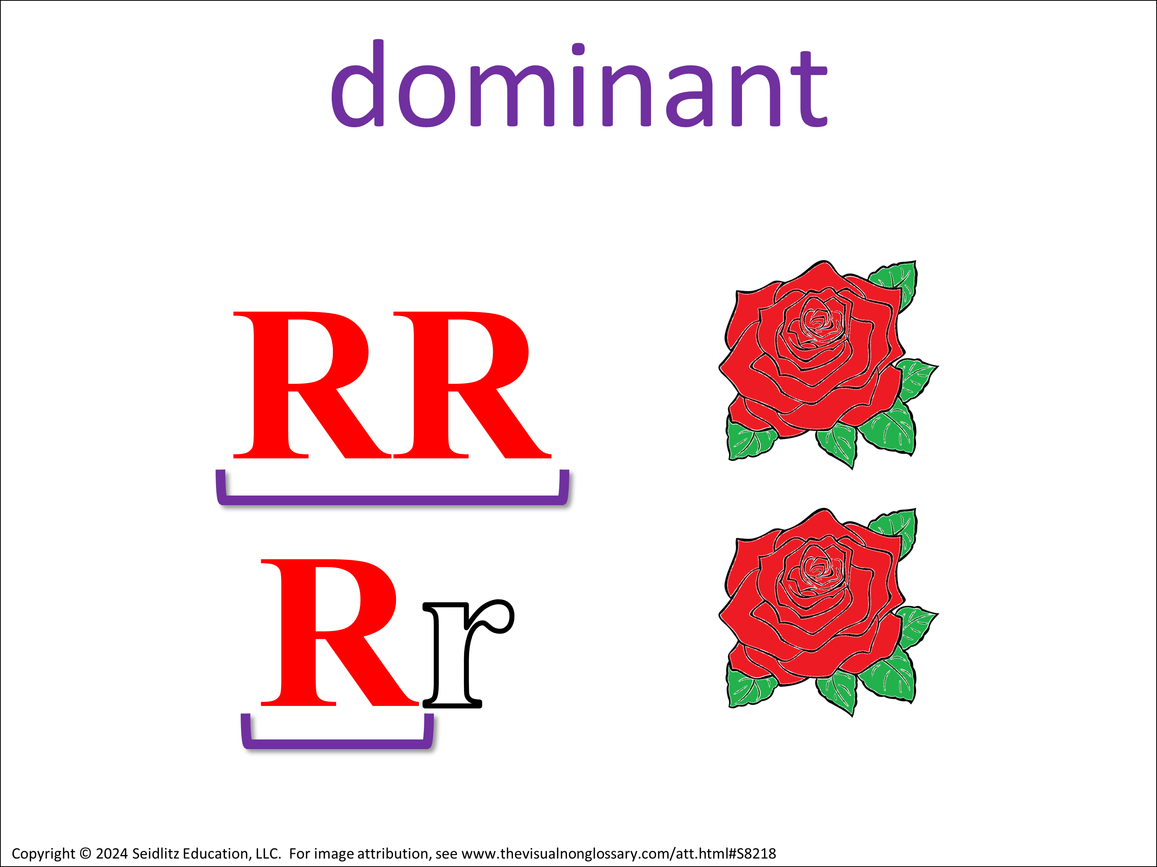

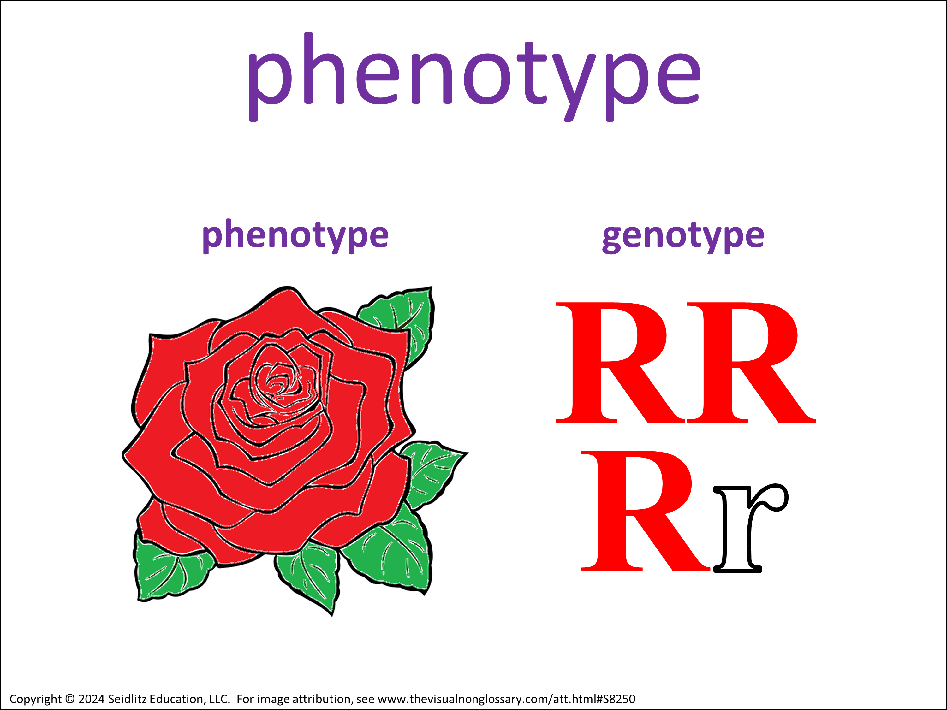
Content Objective
Today we will learn about the term recessive.
Language Objective
In complete sentences: If an organism has a recessive phenotype, what does that tell you about that organism's genotype? If an organism has a recessive phenotype, it means…? Use the vocabulary words to the right in your response.
Notes:
It is recommended that the language objective is writing (for Grades 2-12) with speaking occurring during structured conversations throughout the lesson.
The content objective can be edited to use the specific verbiage of the learning standard. Note: these objectives are simplified for easier implementation. For more information about content and language objectives, see 7 Steps to a Language-Rich Interactive Classroom by John Seidlitz & Bill Perryman (p.118-123).

Slide 6





If an organism has a recessive phenotype, what does that tell you about that organism's genotype?
Choose a sentence stem to share:
• I think the question is asking...
• I think that the term ____ means… because…
• The picture makes me thinks of… because…
• I think that the term ____ is important to the question because…
Notes:
Introductory Structured Conversation:
This activity is called Gearing Up for the Guiding Question and is described in more detail in Teaching Science to English Learners by Stephen Fleenor and Tina Beene (p.24-25).
ELPS
Listening:
2(C) learn new language structures, expressions, and basic and academic vocabulary heard during classroom instruction and interactions;
2(E) use visual, contextual, and linguistic support to enhance and confirm understanding of increasingly complex and elaborated spoken language;
2(I) demonstrate listening comprehension of increasingly complex spoken English by following directions, retelling or summarizing spoken messages, responding to questions and requests, collaborating with peers, and taking notes commensurate with content and grade-level needs.
Speaking:
3(A) practice producing sounds of newly acquired vocabulary such as long and short vowels, silent letters, and consonant clusters to pronounce English words in a manner that is increasingly comprehensible;
3(B) expand and internalize initial English vocabulary by learning and using high-frequency English words necessary for identifying and describing people, places, and objects, by retelling simple stories and basic information represented or supported by pictures, and by learning and using routine language needed for classroom communication;
3(D) speak using grade-level content area vocabulary in context to internalize new English words and build academic language proficiency;
3(E) share information in cooperative learning interactions;
3(G) express opinions, ideas, and feelings ranging from communicating single words and short phrases to participating in extended discussions on a variety of social and grade-appropriate academic topics;
3(J) respond orally to information presented in a wide variety of print, electronic, audio, and visual media to build and reinforce concept and language attainment.
Reading:
4(D) use prereading supports such as graphic organizers, illustrations, and pretaught topic-related vocabulary and other prereading activities to enhance comprehension of written text;
4(F) use visual and contextual support and support from peers and teachers to read grade-appropriate content area text, enhance and confirm understanding, and develop vocabulary, grasp of language structures, and background knowledge needed to comprehend increasingly challenging language;

Slide 7

Notes:
Print this slide out and display it on your word wall, or use this image to as a simplified scaffold in structured conversations.

Slide 8
Notes:
Print this slide out and display it on your word wall, or use this image to as a simplified scaffold in structured conversations.

Slide 9
Notes:
Print this slide out and display it on your word wall, or use this image to as a simplified scaffold in structured conversations.

Slide 10
Notes:
Print this slide out and display it on your word wall, or use this image to as a simplified scaffold in structured conversations.

Slide 11
Notes:
Print this slide out and display it on your word wall, or use this image to as a simplified scaffold in structured conversations.

Slide 12




Observational Question
What does recessive mean?
Recessive means…
Signal:
Share:
Goes 1ˢᵗ:
A
Assess:
Notes:
Structured Conversations:
This activity is called QSSSA and is described in more detail in Teaching Science to English Learners by Stephen Fleenor and Tina Beene (p.29)
Script:
• Class, let’s pronounce this word out loud: (read vocabulary word out loud slowly).
• Can everybody _______ (signal). Think about this question. When you are ready to finish this sentence, _______(stem), show me by _______ (undo the signal).
• You are going to share with _______ (signal) The person in your group that will go first is _______ (share).
• I’m going to _______ (assess). It’s okay if you say what you said or what your partner said, as long as you use ________ (vocabulary word) in a complete sentence. I recommend you use the sentence stem, ________ (stem).
ELPS
Listening:
2(C) learn new language structures, expressions, and basic and academic vocabulary heard during classroom instruction and interactions;
2(E) use visual, contextual, and linguistic support to enhance and confirm understanding of increasingly complex and elaborated spoken language;
2(I) demonstrate listening comprehension of increasingly complex spoken English by following directions, retelling or summarizing spoken messages, responding to questions and requests, collaborating with peers, and taking notes commensurate with content and grade-level needs.
Speaking:
3(A) practice producing sounds of newly acquired vocabulary such as long and short vowels, silent letters, and consonant clusters to pronounce English words in a manner that is increasingly comprehensible;
3(B) expand and internalize initial English vocabulary by learning and using high-frequency English words necessary for identifying and describing people, places, and objects, by retelling simple stories and basic information represented or supported by pictures, and by learning and using routine language needed for classroom communication;
3(D) speak using grade-level content area vocabulary in context to internalize new English words and build academic language proficiency;
3(E) share information in cooperative learning interactions;
3(G) express opinions, ideas, and feelings ranging from communicating single words and short phrases to participating in extended discussions on a variety of social and grade-appropriate academic topics;
3(J) respond orally to information presented in a wide variety of print, electronic, audio, and visual media to build and reinforce concept and language attainment.
Reading:
4(D) use prereading supports such as graphic organizers, illustrations, and pretaught topic-related vocabulary and other prereading activities to enhance comprehension of written text;
4(F) use visual and contextual support and support from peers and teachers to read grade-appropriate content area text, enhance and confirm understanding, and develop vocabulary, grasp of language structures, and background knowledge needed to comprehend increasingly challenging language;

Slide 13
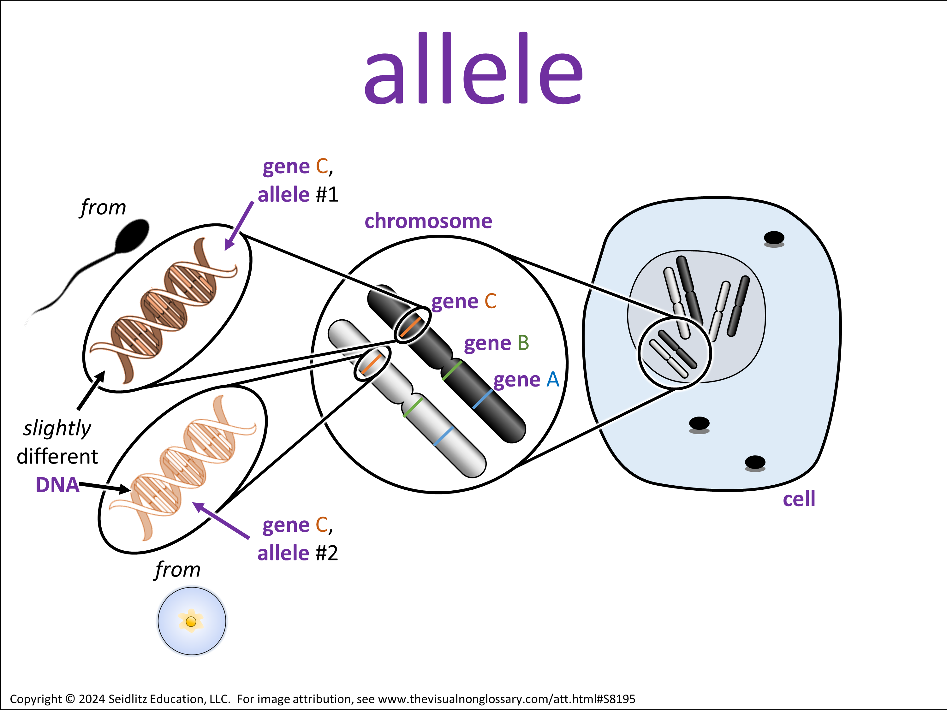
Observational Question
What is an allele?
An allele is…
Signal:
Share:
Goes 1ˢᵗ:
A
Assess:
Notes:
Structured Conversations:
This activity is called QSSSA and is described in more detail in Teaching Science to English Learners by Stephen Fleenor and Tina Beene (p.29)
Script:
• Class, let’s pronounce this word out loud: (read vocabulary word out loud slowly).
• Can everybody _______ (signal). Think about this question. When you are ready to finish this sentence, _______(stem), show me by _______ (undo the signal).
• You are going to share with _______ (signal) The person in your group that will go first is _______ (share).
• I’m going to _______ (assess). It’s okay if you say what you said or what your partner said, as long as you use ________ (vocabulary word) in a complete sentence. I recommend you use the sentence stem, ________ (stem).
ELPS
Listening:
2(C) learn new language structures, expressions, and basic and academic vocabulary heard during classroom instruction and interactions;
2(E) use visual, contextual, and linguistic support to enhance and confirm understanding of increasingly complex and elaborated spoken language;
2(I) demonstrate listening comprehension of increasingly complex spoken English by following directions, retelling or summarizing spoken messages, responding to questions and requests, collaborating with peers, and taking notes commensurate with content and grade-level needs.
Speaking:
3(A) practice producing sounds of newly acquired vocabulary such as long and short vowels, silent letters, and consonant clusters to pronounce English words in a manner that is increasingly comprehensible;
3(B) expand and internalize initial English vocabulary by learning and using high-frequency English words necessary for identifying and describing people, places, and objects, by retelling simple stories and basic information represented or supported by pictures, and by learning and using routine language needed for classroom communication;
3(D) speak using grade-level content area vocabulary in context to internalize new English words and build academic language proficiency;
3(E) share information in cooperative learning interactions;
3(G) express opinions, ideas, and feelings ranging from communicating single words and short phrases to participating in extended discussions on a variety of social and grade-appropriate academic topics;
3(J) respond orally to information presented in a wide variety of print, electronic, audio, and visual media to build and reinforce concept and language attainment.
Reading:
4(D) use prereading supports such as graphic organizers, illustrations, and pretaught topic-related vocabulary and other prereading activities to enhance comprehension of written text;
4(F) use visual and contextual support and support from peers and teachers to read grade-appropriate content area text, enhance and confirm understanding, and develop vocabulary, grasp of language structures, and background knowledge needed to comprehend increasingly challenging language;

Slide 14



Relational Question
How is a recessive allele different from a dominant allele?
A recessive allele is different from a dominant allele because…
Signal:
Share:
Goes 1ˢᵗ:
A
Assess:
Notes:
Structured Conversations:
Delete or hide this slide if the relational question does not refer to two vocabulary words which each have a visual.
This activity is called QSSSA and is described in more detail in Teaching Science to English Learners by Stephen Fleenor and Tina Beene (p.29)
Script:
• Can everybody _______ (signal). Think about this question. When you are ready to finish this sentence, _______(stem), show me by _______ (undo the signal).
• You are going to share with _______ (signal) The person in your group that will go first is _______ (share).
• I’m going to _______ (assess). It’s okay if you say what you said or what your partner said, as long as you use ________ (vocabulary word) in a complete sentence. I recommend you use the sentence stem, ________ (stem).
ELPS
Listening:
2(C) learn new language structures, expressions, and basic and academic vocabulary heard during classroom instruction and interactions;
2(E) use visual, contextual, and linguistic support to enhance and confirm understanding of increasingly complex and elaborated spoken language;
2(I) demonstrate listening comprehension of increasingly complex spoken English by following directions, retelling or summarizing spoken messages, responding to questions and requests, collaborating with peers, and taking notes commensurate with content and grade-level needs.
Speaking:
3(A) practice producing sounds of newly acquired vocabulary such as long and short vowels, silent letters, and consonant clusters to pronounce English words in a manner that is increasingly comprehensible;
3(B) expand and internalize initial English vocabulary by learning and using high-frequency English words necessary for identifying and describing people, places, and objects, by retelling simple stories and basic information represented or supported by pictures, and by learning and using routine language needed for classroom communication;
3(D) speak using grade-level content area vocabulary in context to internalize new English words and build academic language proficiency;
3(E) share information in cooperative learning interactions;
3(G) express opinions, ideas, and feelings ranging from communicating single words and short phrases to participating in extended discussions on a variety of social and grade-appropriate academic topics;
3(J) respond orally to information presented in a wide variety of print, electronic, audio, and visual media to build and reinforce concept and language attainment.
Reading:
4(D) use prereading supports such as graphic organizers, illustrations, and pretaught topic-related vocabulary and other prereading activities to enhance comprehension of written text;
4(F) use visual and contextual support and support from peers and teachers to read grade-appropriate content area text, enhance and confirm understanding, and develop vocabulary, grasp of language structures, and background knowledge needed to comprehend increasingly challenging language;

Slide 15
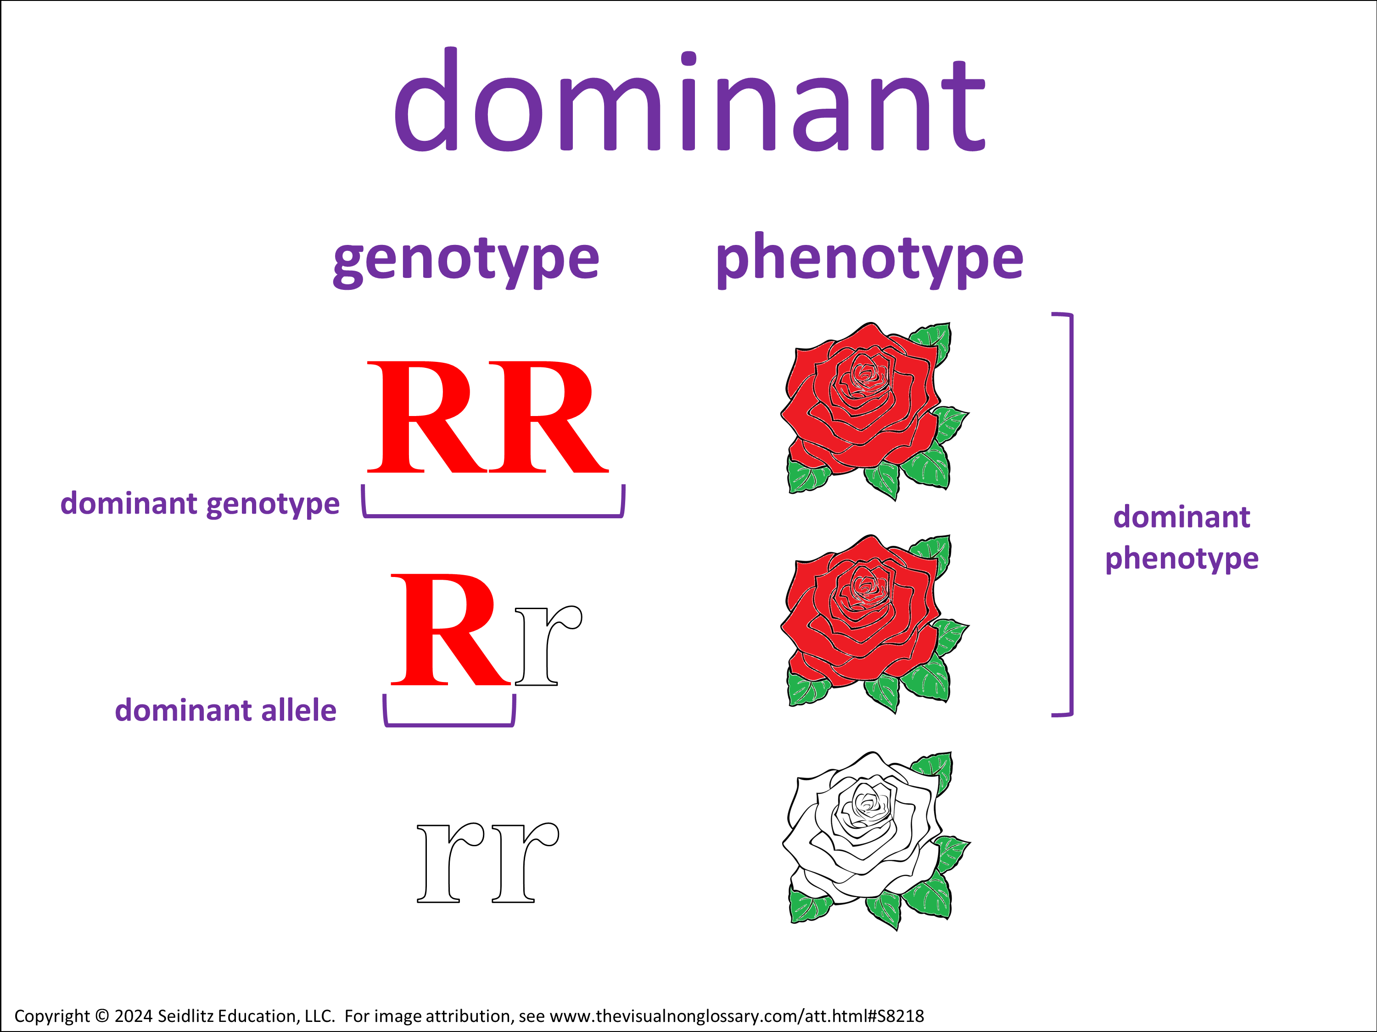
Observational Question
How would you know if an allele is dominant?
I would know if an allele is dominant if…
Signal:
Share:
Goes 1ˢᵗ:
A
Assess:
Notes:
Structured Conversations:
This activity is called QSSSA and is described in more detail in Teaching Science to English Learners by Stephen Fleenor and Tina Beene (p.29)
Script:
• Class, let’s pronounce this word out loud: (read vocabulary word out loud slowly).
• Can everybody _______ (signal). Think about this question. When you are ready to finish this sentence, _______(stem), show me by _______ (undo the signal).
• You are going to share with _______ (signal) The person in your group that will go first is _______ (share).
• I’m going to _______ (assess). It’s okay if you say what you said or what your partner said, as long as you use ________ (vocabulary word) in a complete sentence. I recommend you use the sentence stem, ________ (stem).
ELPS
Listening:
2(C) learn new language structures, expressions, and basic and academic vocabulary heard during classroom instruction and interactions;
2(E) use visual, contextual, and linguistic support to enhance and confirm understanding of increasingly complex and elaborated spoken language;
2(I) demonstrate listening comprehension of increasingly complex spoken English by following directions, retelling or summarizing spoken messages, responding to questions and requests, collaborating with peers, and taking notes commensurate with content and grade-level needs.
Speaking:
3(A) practice producing sounds of newly acquired vocabulary such as long and short vowels, silent letters, and consonant clusters to pronounce English words in a manner that is increasingly comprehensible;
3(B) expand and internalize initial English vocabulary by learning and using high-frequency English words necessary for identifying and describing people, places, and objects, by retelling simple stories and basic information represented or supported by pictures, and by learning and using routine language needed for classroom communication;
3(D) speak using grade-level content area vocabulary in context to internalize new English words and build academic language proficiency;
3(E) share information in cooperative learning interactions;
3(G) express opinions, ideas, and feelings ranging from communicating single words and short phrases to participating in extended discussions on a variety of social and grade-appropriate academic topics;
3(J) respond orally to information presented in a wide variety of print, electronic, audio, and visual media to build and reinforce concept and language attainment.
Reading:
4(D) use prereading supports such as graphic organizers, illustrations, and pretaught topic-related vocabulary and other prereading activities to enhance comprehension of written text;
4(F) use visual and contextual support and support from peers and teachers to read grade-appropriate content area text, enhance and confirm understanding, and develop vocabulary, grasp of language structures, and background knowledge needed to comprehend increasingly challenging language;

Slide 16
Relational Question
How is a recessive allele different from a dominant allele?
A recessive allele is different from a dominant allele because…
Signal:
Share:
Goes 1ˢᵗ:
A
Assess:
Notes:
Structured Conversations:
Delete or hide this slide if the relational question does not refer to two vocabulary words which each have a visual.
This activity is called QSSSA and is described in more detail in Teaching Science to English Learners by Stephen Fleenor and Tina Beene (p.29)
Script:
• Can everybody _______ (signal). Think about this question. When you are ready to finish this sentence, _______(stem), show me by _______ (undo the signal).
• You are going to share with _______ (signal) The person in your group that will go first is _______ (share).
• I’m going to _______ (assess). It’s okay if you say what you said or what your partner said, as long as you use ________ (vocabulary word) in a complete sentence. I recommend you use the sentence stem, ________ (stem).
ELPS
Listening:
2(C) learn new language structures, expressions, and basic and academic vocabulary heard during classroom instruction and interactions;
2(E) use visual, contextual, and linguistic support to enhance and confirm understanding of increasingly complex and elaborated spoken language;
2(I) demonstrate listening comprehension of increasingly complex spoken English by following directions, retelling or summarizing spoken messages, responding to questions and requests, collaborating with peers, and taking notes commensurate with content and grade-level needs.
Speaking:
3(A) practice producing sounds of newly acquired vocabulary such as long and short vowels, silent letters, and consonant clusters to pronounce English words in a manner that is increasingly comprehensible;
3(B) expand and internalize initial English vocabulary by learning and using high-frequency English words necessary for identifying and describing people, places, and objects, by retelling simple stories and basic information represented or supported by pictures, and by learning and using routine language needed for classroom communication;
3(D) speak using grade-level content area vocabulary in context to internalize new English words and build academic language proficiency;
3(E) share information in cooperative learning interactions;
3(G) express opinions, ideas, and feelings ranging from communicating single words and short phrases to participating in extended discussions on a variety of social and grade-appropriate academic topics;
3(J) respond orally to information presented in a wide variety of print, electronic, audio, and visual media to build and reinforce concept and language attainment.
Reading:
4(D) use prereading supports such as graphic organizers, illustrations, and pretaught topic-related vocabulary and other prereading activities to enhance comprehension of written text;
4(F) use visual and contextual support and support from peers and teachers to read grade-appropriate content area text, enhance and confirm understanding, and develop vocabulary, grasp of language structures, and background knowledge needed to comprehend increasingly challenging language;

Slide 17
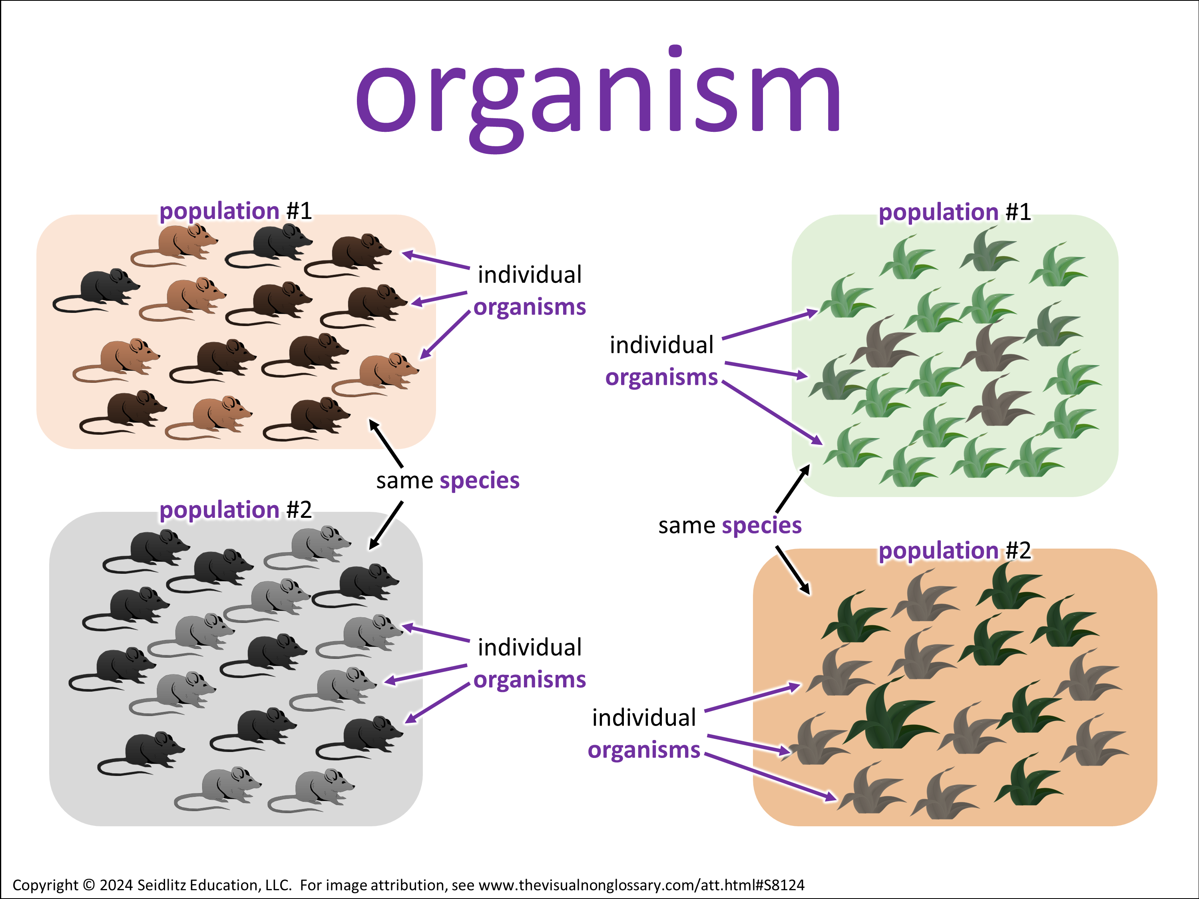
Observational Question
What is an organism?
An organism is…
Signal:
Share:
Goes 1ˢᵗ:
A
Assess:
Notes:
Structured Conversations:
This activity is called QSSSA and is described in more detail in Teaching Science to English Learners by Stephen Fleenor and Tina Beene (p.29)
Script:
• Class, let’s pronounce this word out loud: (read vocabulary word out loud slowly).
• Can everybody _______ (signal). Think about this question. When you are ready to finish this sentence, _______(stem), show me by _______ (undo the signal).
• You are going to share with _______ (signal) The person in your group that will go first is _______ (share).
• I’m going to _______ (assess). It’s okay if you say what you said or what your partner said, as long as you use ________ (vocabulary word) in a complete sentence. I recommend you use the sentence stem, ________ (stem).
ELPS
Listening:
2(C) learn new language structures, expressions, and basic and academic vocabulary heard during classroom instruction and interactions;
2(E) use visual, contextual, and linguistic support to enhance and confirm understanding of increasingly complex and elaborated spoken language;
2(I) demonstrate listening comprehension of increasingly complex spoken English by following directions, retelling or summarizing spoken messages, responding to questions and requests, collaborating with peers, and taking notes commensurate with content and grade-level needs.
Speaking:
3(A) practice producing sounds of newly acquired vocabulary such as long and short vowels, silent letters, and consonant clusters to pronounce English words in a manner that is increasingly comprehensible;
3(B) expand and internalize initial English vocabulary by learning and using high-frequency English words necessary for identifying and describing people, places, and objects, by retelling simple stories and basic information represented or supported by pictures, and by learning and using routine language needed for classroom communication;
3(D) speak using grade-level content area vocabulary in context to internalize new English words and build academic language proficiency;
3(E) share information in cooperative learning interactions;
3(G) express opinions, ideas, and feelings ranging from communicating single words and short phrases to participating in extended discussions on a variety of social and grade-appropriate academic topics;
3(J) respond orally to information presented in a wide variety of print, electronic, audio, and visual media to build and reinforce concept and language attainment.
Reading:
4(D) use prereading supports such as graphic organizers, illustrations, and pretaught topic-related vocabulary and other prereading activities to enhance comprehension of written text;
4(F) use visual and contextual support and support from peers and teachers to read grade-appropriate content area text, enhance and confirm understanding, and develop vocabulary, grasp of language structures, and background knowledge needed to comprehend increasingly challenging language;

Slide 18
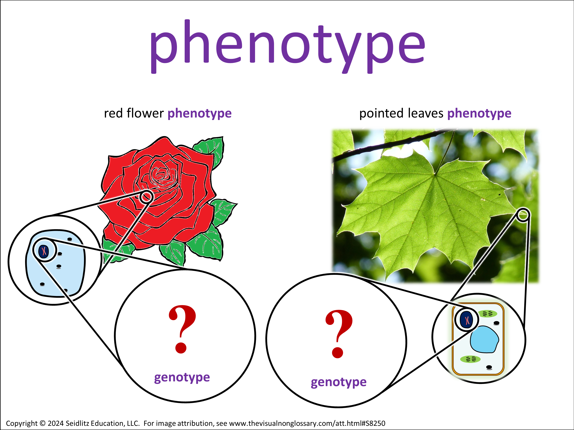
Observational Question
Pheno- means “appear.” How is a phenotype related to “appearing?”
A phenotype is related to appearing because…
Signal:
Share:
Goes 1ˢᵗ:
A
Assess:
Notes:
Structured Conversations:
This activity is called QSSSA and is described in more detail in Teaching Science to English Learners by Stephen Fleenor and Tina Beene (p.29)
Script:
• Class, let’s pronounce this word out loud: (read vocabulary word out loud slowly).
• Can everybody _______ (signal). Think about this question. When you are ready to finish this sentence, _______(stem), show me by _______ (undo the signal).
• You are going to share with _______ (signal) The person in your group that will go first is _______ (share).
• I’m going to _______ (assess). It’s okay if you say what you said or what your partner said, as long as you use ________ (vocabulary word) in a complete sentence. I recommend you use the sentence stem, ________ (stem).
ELPS
Listening:
2(C) learn new language structures, expressions, and basic and academic vocabulary heard during classroom instruction and interactions;
2(E) use visual, contextual, and linguistic support to enhance and confirm understanding of increasingly complex and elaborated spoken language;
2(I) demonstrate listening comprehension of increasingly complex spoken English by following directions, retelling or summarizing spoken messages, responding to questions and requests, collaborating with peers, and taking notes commensurate with content and grade-level needs.
Speaking:
3(A) practice producing sounds of newly acquired vocabulary such as long and short vowels, silent letters, and consonant clusters to pronounce English words in a manner that is increasingly comprehensible;
3(B) expand and internalize initial English vocabulary by learning and using high-frequency English words necessary for identifying and describing people, places, and objects, by retelling simple stories and basic information represented or supported by pictures, and by learning and using routine language needed for classroom communication;
3(D) speak using grade-level content area vocabulary in context to internalize new English words and build academic language proficiency;
3(E) share information in cooperative learning interactions;
3(G) express opinions, ideas, and feelings ranging from communicating single words and short phrases to participating in extended discussions on a variety of social and grade-appropriate academic topics;
3(J) respond orally to information presented in a wide variety of print, electronic, audio, and visual media to build and reinforce concept and language attainment.
Reading:
4(D) use prereading supports such as graphic organizers, illustrations, and pretaught topic-related vocabulary and other prereading activities to enhance comprehension of written text;
4(F) use visual and contextual support and support from peers and teachers to read grade-appropriate content area text, enhance and confirm understanding, and develop vocabulary, grasp of language structures, and background knowledge needed to comprehend increasingly challenging language;

Slide 19






Language Objective:
If an organism has a recessive phenotype, what does that tell you about that organism's genotype?
If an organism has a recessive phenotype, it means…?
How ready are you to answer this question, in complete sentences, using the key vocabulary?
I am not ready
I am almost ready
I am completely ready
Notes:
Check for Understanding. This is important because the next slide is the final structured conversation slide and is also recommended to be the exit ticket question.

Slide 20




Inferential Question
If an organism has a recessive phenotype, what does that tell you about that organism's genotype?
If an organism has a recessive phenotype, it means…?
Signal:
Share:
Goes 1ˢᵗ:
A
Assess:
Notes:
Structured Conversations:
Recommended: use this or the final extension activity (writing a paragraph) as a closure or exit ticket. Have students discuss their answers in groups, then write their answers.
This activity is called QSSSA and is described in more detail in Teaching Science to English Learners by Stephen Fleenor and Tina Beene (p.29)
Script:
• Can everybody _______ (signal). Think about this question. When you are ready to finish this sentence, _______(stem), show me by _______ (undo the signal).
• You are going to share with _______ (signal) The person in your group that will go first is _______ (share).
• I’m going to _______ (assess). It’s okay if you say what you said or what your partner said, as long as you use ________ (vocabulary word) in a complete sentence. I recommend you use the sentence stem, ________ (stem).
ELPS
Listening:
2(C) learn new language structures, expressions, and basic and academic vocabulary heard during classroom instruction and interactions;
2(E) use visual, contextual, and linguistic support to enhance and confirm understanding of increasingly complex and elaborated spoken language;
2(I) demonstrate listening comprehension of increasingly complex spoken English by following directions, retelling or summarizing spoken messages, responding to questions and requests, collaborating with peers, and taking notes commensurate with content and grade-level needs.
Speaking:
3(A) practice producing sounds of newly acquired vocabulary such as long and short vowels, silent letters, and consonant clusters to pronounce English words in a manner that is increasingly comprehensible;
3(B) expand and internalize initial English vocabulary by learning and using high-frequency English words necessary for identifying and describing people, places, and objects, by retelling simple stories and basic information represented or supported by pictures, and by learning and using routine language needed for classroom communication;
3(D) speak using grade-level content area vocabulary in context to internalize new English words and build academic language proficiency;
3(E) share information in cooperative learning interactions;
3(G) express opinions, ideas, and feelings ranging from communicating single words and short phrases to participating in extended discussions on a variety of social and grade-appropriate academic topics;
3(J) respond orally to information presented in a wide variety of print, electronic, audio, and visual media to build and reinforce concept and language attainment.
Reading:
4(D) use prereading supports such as graphic organizers, illustrations, and pretaught topic-related vocabulary and other prereading activities to enhance comprehension of written text;
4(F) use visual and contextual support and support from peers and teachers to read grade-appropriate content area text, enhance and confirm understanding, and develop vocabulary, grasp of language structures, and background knowledge needed to comprehend increasingly challenging language;

Slide 21
Extension Activities​
Use any or all of the activities in the following slides, either between structured conversations or after students have completed all of the structured conversations.
• Draw and Write
Have students draw the vocabulary word and label it with key lesson terms, then write about how it connects to their understanding of the word.
• Complete the Picture
Do this before showing the complete visual for a prediction activity, or after showing the visual for a recall exercise.
• Fill It In
Like “Complete the Picture”, this activity is also excellent as either a preview or a review.
• Questioning Conversation
Encourage open-ended dialogue about the visual with question-asking and prediction-making
• Vocab Connection Web
Have students make connections to other words in this unit, or other words in previous units. Excellent as a unit review!
• Roving Paragraph
Get students moving, and writing! Can be done at any point in the lesson, but it makes an excellent review at the end of the lesson.
• Open Writing
This is highly recommended after the structured conversations are complete, as a closure/exit ticket to the lesson. Have students write everything they’ve learned about the vocabulary word, structured with the sentence stems of their structured conversations and key vocabulary.
Notes:
For the teacher, not to be displayed to students.

Slide 22

Draw and Write
recessive
Draw a representation for the term recessive. Label your visual with the terms: • • • • •
Notes:
It is recommended that this activity is done as a warm-up before being introduced to the word, or as a review at the end of the lesson. This activity can be done independently or in groups.
This activity is called Complete the Pictured and is described in more detail in Teaching Science to English Learners by Stephen Fleenor and Tina Beene (p.30)

Slide 23
Draw and Write
recessive
Explain how your visual relates to what you’ve learned about recessive • My visual is… • It relates to what I’ve learned about recessive because...
Notes:
It is recommended that this activity is done as a warm-up before being introduced to the word, or as a review at the end of the lesson. This activity can be done independently or in groups.
This activity is called Complete the Pictured and is described in more detail in Teaching Science to English Learners by Stephen Fleenor and Tina Beene (p.30)

Slide 24

Complete the Picture
Draw what you think the rest of the image looks like for the term recessive.
Notes:
It is recommended that this activity is done as a warm-up before being introduced to the word, or as a review at the end of the lesson. This activity can be done independently or in groups.
This activity is called Complete the Pictured and is described in more detail in Teaching Science to English Learners by Stephen Fleenor and Tina Beene (p.30)

Slide 25
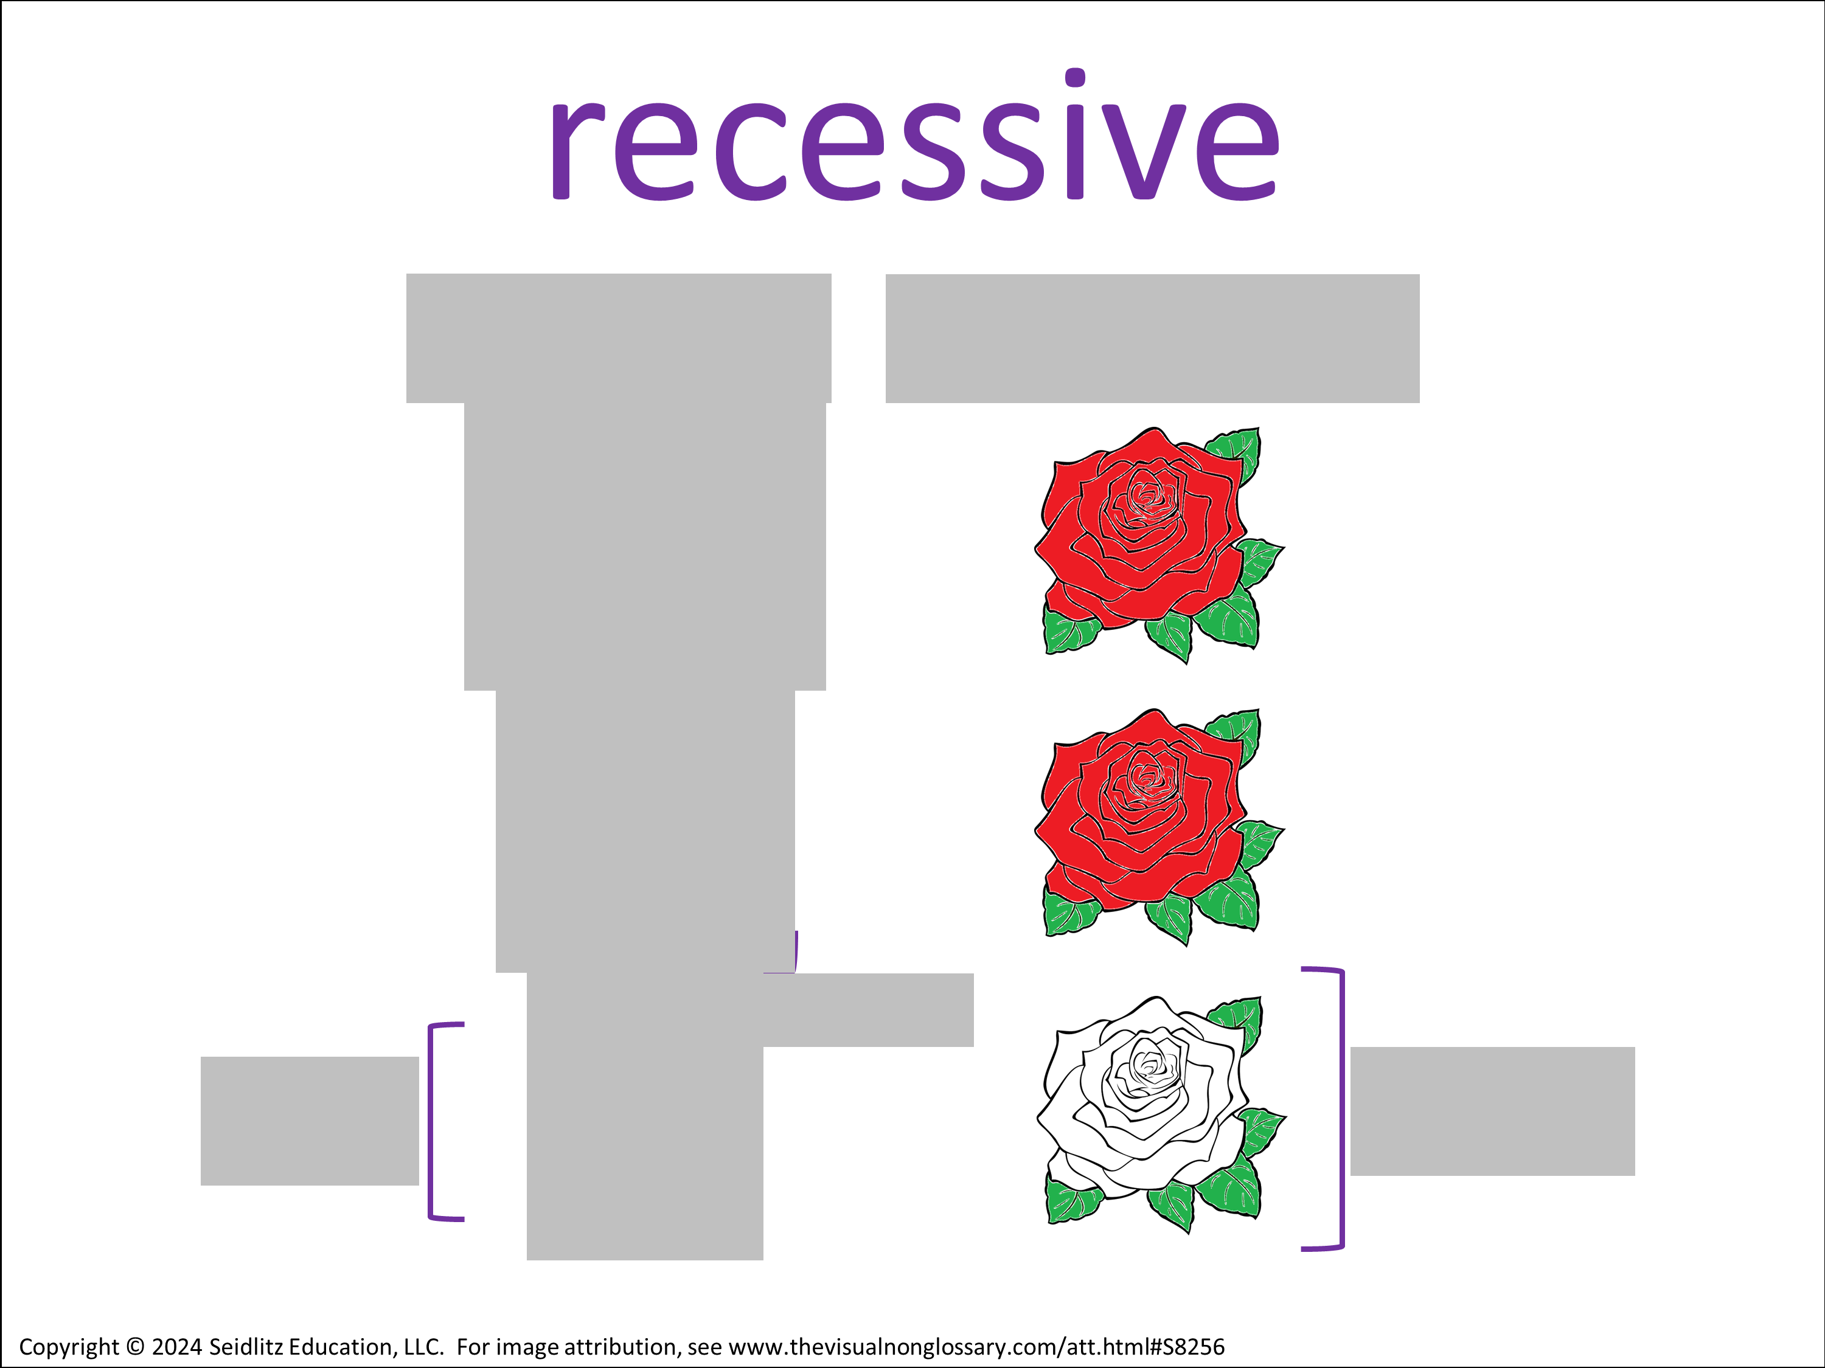
Fill It In
Fill in the grey boxes in this visual as best you can. Work with a partner or share your completed visual with a partner when you finish.
Notes:
It is recommended that this activity is done as a prediction warm-up before being introduced to the word, or as a review at the end of the lesson. This activity can be done independently or in groups.
This activity is called Complete the Pictured and is described in more detail in Teaching Science to English Learners by Stephen Fleenor and Tina Beene (p.30)

Slide 26
Questioning Conversation
Choose a stem:
• One thing I don’t know is…
• One thing I wonder is…
• I did not understand when we talked about ______, but I think…
Signal:
Share:
Goes 1ˢᵗ:
A
Assess:
Notes:
It is recommended that this activity is done in groups, and that students are encouraged to pick any one of the three sentence stems.
This activity is called Questioning Conversation and is described in more detail in Teaching Science to English Learners by Stephen Fleenor and Tina Beene (p.31)
ELPS
Listening:
2(C) learn new language structures, expressions, and basic and academic vocabulary heard during classroom instruction and interactions;
2(E) use visual, contextual, and linguistic support to enhance and confirm understanding of increasingly complex and elaborated spoken language;
2(I) demonstrate listening comprehension of increasingly complex spoken English by following directions, retelling or summarizing spoken messages, responding to questions and requests, collaborating with peers, and taking notes commensurate with content and grade-level needs.
Speaking:
3(A) practice producing sounds of newly acquired vocabulary such as long and short vowels, silent letters, and consonant clusters to pronounce English words in a manner that is increasingly comprehensible;
3(B) expand and internalize initial English vocabulary by learning and using high-frequency English words necessary for identifying and describing people, places, and objects, by retelling simple stories and basic information represented or supported by pictures, and by learning and using routine language needed for classroom communication;
3(D) speak using grade-level content area vocabulary in context to internalize new English words and build academic language proficiency;
3(E) share information in cooperative learning interactions;
3(G) express opinions, ideas, and feelings ranging from communicating single words and short phrases to participating in extended discussions on a variety of social and grade-appropriate academic topics;
3(J) respond orally to information presented in a wide variety of print, electronic, audio, and visual media to build and reinforce concept and language attainment.
Reading:
4(D) use prereading supports such as graphic organizers, illustrations, and pretaught topic-related vocabulary and other prereading activities to enhance comprehension of written text;
4(F) use visual and contextual support and support from peers and teachers to read grade-appropriate content area text, enhance and confirm understanding, and develop vocabulary, grasp of language structures, and background knowledge needed to comprehend increasingly challenging language;

Slide 27
Questioning Conversation
Choose a hypothesis:
• I think…
• Based on ______, I believe…
• ______ makes me think ______ because…
Signal:
Share:
Goes 1ˢᵗ:
A
Assess:
Notes:
It is recommended that this activity is done in groups, and that students are encouraged to pick any one of the sentence stems, regardless of what they previously chose. Note: if short on time, this second part of the activity can be skipped.
This activity is called Questioning Conversation and is described in more detail in Teaching Science to English Learners by Stephen Fleenor and Tina Beene (p.31)
ELPS
Listening:
2(C) learn new language structures, expressions, and basic and academic vocabulary heard during classroom instruction and interactions;
2(E) use visual, contextual, and linguistic support to enhance and confirm understanding of increasingly complex and elaborated spoken language;
2(I) demonstrate listening comprehension of increasingly complex spoken English by following directions, retelling or summarizing spoken messages, responding to questions and requests, collaborating with peers, and taking notes commensurate with content and grade-level needs.
Speaking:
3(A) practice producing sounds of newly acquired vocabulary such as long and short vowels, silent letters, and consonant clusters to pronounce English words in a manner that is increasingly comprehensible;
3(B) expand and internalize initial English vocabulary by learning and using high-frequency English words necessary for identifying and describing people, places, and objects, by retelling simple stories and basic information represented or supported by pictures, and by learning and using routine language needed for classroom communication;
3(D) speak using grade-level content area vocabulary in context to internalize new English words and build academic language proficiency;
3(E) share information in cooperative learning interactions;
3(G) express opinions, ideas, and feelings ranging from communicating single words and short phrases to participating in extended discussions on a variety of social and grade-appropriate academic topics;
3(J) respond orally to information presented in a wide variety of print, electronic, audio, and visual media to build and reinforce concept and language attainment.
Reading:
4(D) use prereading supports such as graphic organizers, illustrations, and pretaught topic-related vocabulary and other prereading activities to enhance comprehension of written text;
4(F) use visual and contextual support and support from peers and teachers to read grade-appropriate content area text, enhance and confirm understanding, and develop vocabulary, grasp of language structures, and background knowledge needed to comprehend increasingly challenging language;

Slide 28

Vocab Connection Web
Make a word map connecting recessive to 3-5 other vocabulary words.
Next to each connecting line, describe how the two words are related.
Work with a partner or share your word map with a partner when you finish.
Notes:
For example, if the central word is “atom”, a student might:
• Make a connection to “proton” and write “atoms contain protons” next to the connecting line.
• Make a connection to “molecule” and write “atoms make up molecules” next to the connecting line.
• Make a connection to “matter” and write “atoms are the smallest units of matter” next to the connecting line.
• Make a connection to “nucleus” and write “the center of an atom is the nucleus” next to the connecting line.
Alternatively, students can create a Vocab Connection Web (Teaching Science to English Learners by Fleenor and Beene, 2019, p.53) in which any connection can be made between any two words – there does not have a to a “central” word.
ELPS
Listening:
2(C) learn new language structures, expressions, and basic and academic vocabulary heard during classroom instruction and interactions;
2(E) use visual, contextual, and linguistic support to enhance and confirm understanding of increasingly complex and elaborated spoken language;
2(I) demonstrate listening comprehension of increasingly complex spoken English by following directions, retelling or summarizing spoken messages, responding to questions and requests, collaborating with peers, and taking notes commensurate with content and grade-level needs.
Speaking:
3(A) practice producing sounds of newly acquired vocabulary such as long and short vowels, silent letters, and consonant clusters to pronounce English words in a manner that is increasingly comprehensible;
3(B) expand and internalize initial English vocabulary by learning and using high-frequency English words necessary for identifying and describing people, places, and objects, by retelling simple stories and basic information represented or supported by pictures, and by learning and using routine language needed for classroom communication;
3(D) speak using grade-level content area vocabulary in context to internalize new English words and build academic language proficiency;
3(E) share information in cooperative learning interactions;
3(G) express opinions, ideas, and feelings ranging from communicating single words and short phrases to participating in extended discussions on a variety of social and grade-appropriate academic topics;
3(J) respond orally to information presented in a wide variety of print, electronic, audio, and visual media to build and reinforce concept and language attainment.
Reading:
4(D) use prereading supports such as graphic organizers, illustrations, and pretaught topic-related vocabulary and other prereading activities to enhance comprehension of written text;
4(F) use visual and contextual support and support from peers and teachers to read grade-appropriate content area text, enhance and confirm understanding, and develop vocabulary, grasp of language structures, and background knowledge needed to comprehend increasingly challenging language;
Writing:
5(G) narrate, describe, and explain with increasing specificity and detail to fulfill content area writing needs as more English is acquired.
5(F) write using a variety of grade-appropriate sentence lengths, patterns, and connecting words to combine phrases, clauses, and sentences in increasingly accurate ways as more English is acquired; and
5(G) narrate, describe, and explain with increasing specificity and detail to fulfill content area writing needs as more English is acquired.

Slide 29
Roving Paragraph​
Write a sentence using either sentence stem: The term recessive... From this visual, I can infer… (use recessive in your response)
Notes:
Esta actividad se recomienda especialmente para estimular el movimiento y generar confianza en la alfabetización.
Esta actividad se llama Párrafo móvil y se describe con más detalle en 7 pasos para un aula interactiva y rica en lenguaje (2.ª edición) de John Seidlitz y Bill Perryman (pág. 151).
ELPS
Listening:
2(C) learn new language structures, expressions, and basic and academic vocabulary heard during classroom instruction and interactions;
2(E) use visual, contextual, and linguistic support to enhance and confirm understanding of increasingly complex and elaborated spoken language;
2(I) demonstrate listening comprehension of increasingly complex spoken English by following directions, retelling or summarizing spoken messages, responding to questions and requests, collaborating with peers, and taking notes commensurate with content and grade-level needs.
Speaking:
3(A) practice producing sounds of newly acquired vocabulary such as long and short vowels, silent letters, and consonant clusters to pronounce English words in a manner that is increasingly comprehensible;
3(B) expand and internalize initial English vocabulary by learning and using high-frequency English words necessary for identifying and describing people, places, and objects, by retelling simple stories and basic information represented or supported by pictures, and by learning and using routine language needed for classroom communication;
3(D) speak using grade-level content area vocabulary in context to internalize new English words and build academic language proficiency;
3(E) share information in cooperative learning interactions;
3(G) express opinions, ideas, and feelings ranging from communicating single words and short phrases to participating in extended discussions on a variety of social and grade-appropriate academic topics;
3(J) respond orally to information presented in a wide variety of print, electronic, audio, and visual media to build and reinforce concept and language attainment.
Reading:
4(D) use prereading supports such as graphic organizers, illustrations, and pretaught topic-related vocabulary and other prereading activities to enhance comprehension of written text;
4(F) use visual and contextual support and support from peers and teachers to read grade-appropriate content area text, enhance and confirm understanding, and develop vocabulary, grasp of language structures, and background knowledge needed to comprehend increasingly challenging language;
Writing:
5(B) write using newly acquired basic vocabulary and content-based grade-level vocabulary;
5(F) write using a variety of grade-appropriate sentence lengths, patterns, and connecting words to combine phrases, clauses, and sentences in increasingly accurate ways as more English is acquired; and
5(G) narrate, describe, and explain with increasing specificity and detail to fulfill content area writing needs as more English is acquired.

Slide 30
Roving Paragraph​
Find another student and add their sentence to yours, using a transition word:​ • Also, … • Additionally, … • Furthermore, … • Next, … • For example, … • Lastly, … • Therefore, … Repeat 2 to 4 times.
Notes:
When students are finished, it is recommended that they share their paragraphs with a partner or group, with time afterwards to make any edits to their paragraphs.
ELPS
Listening:
2(C) learn new language structures, expressions, and basic and academic vocabulary heard during classroom instruction and interactions;
2(E) use visual, contextual, and linguistic support to enhance and confirm understanding of increasingly complex and elaborated spoken language;
2(I) demonstrate listening comprehension of increasingly complex spoken English by following directions, retelling or summarizing spoken messages, responding to questions and requests, collaborating with peers, and taking notes commensurate with content and grade-level needs.
Speaking:
3(A) practice producing sounds of newly acquired vocabulary such as long and short vowels, silent letters, and consonant clusters to pronounce English words in a manner that is increasingly comprehensible;
3(B) expand and internalize initial English vocabulary by learning and using high-frequency English words necessary for identifying and describing people, places, and objects, by retelling simple stories and basic information represented or supported by pictures, and by learning and using routine language needed for classroom communication;
3(D) speak using grade-level content area vocabulary in context to internalize new English words and build academic language proficiency;
3(E) share information in cooperative learning interactions;
3(G) express opinions, ideas, and feelings ranging from communicating single words and short phrases to participating in extended discussions on a variety of social and grade-appropriate academic topics;
3(J) respond orally to information presented in a wide variety of print, electronic, audio, and visual media to build and reinforce concept and language attainment.
Reading:
4(D) use prereading supports such as graphic organizers, illustrations, and pretaught topic-related vocabulary and other prereading activities to enhance comprehension of written text;
4(F) use visual and contextual support and support from peers and teachers to read grade-appropriate content area text, enhance and confirm understanding, and develop vocabulary, grasp of language structures, and background knowledge needed to comprehend increasingly challenging language;
Writing:
5(G) narrate, describe, and explain with increasing specificity and detail to fulfill content area writing needs as more English is acquired.
5(F) write using a variety of grade-appropriate sentence lengths, patterns, and connecting words to combine phrases, clauses, and sentences in increasingly accurate ways as more English is acquired; and
5(G) narrate, describe, and explain with increasing specificity and detail to fulfill content area writing needs as more English is acquired.

Slide 31
Open Writing
Write a paragraph describing the term recessive. Include 3-5 other vocabulary words in your paragraph. You may include the following stems:​ • Recessive means… • A recessive allele is different from a dominant allele because… • If an organism has a recessive phenotype, it means…?
Notes:
When students are finished, it is recommended that they share their paragraphs with a partner or group, with time afterwards to make any edits to their paragraphs.
ELPS
Listening:
2(C) learn new language structures, expressions, and basic and academic vocabulary heard during classroom instruction and interactions;
2(E) use visual, contextual, and linguistic support to enhance and confirm understanding of increasingly complex and elaborated spoken language;
2(I) demonstrate listening comprehension of increasingly complex spoken English by following directions, retelling or summarizing spoken messages, responding to questions and requests, collaborating with peers, and taking notes commensurate with content and grade-level needs.
Speaking:
3(A) practice producing sounds of newly acquired vocabulary such as long and short vowels, silent letters, and consonant clusters to pronounce English words in a manner that is increasingly comprehensible;
3(B) expand and internalize initial English vocabulary by learning and using high-frequency English words necessary for identifying and describing people, places, and objects, by retelling simple stories and basic information represented or supported by pictures, and by learning and using routine language needed for classroom communication;
3(D) speak using grade-level content area vocabulary in context to internalize new English words and build academic language proficiency;
3(E) share information in cooperative learning interactions;
3(G) express opinions, ideas, and feelings ranging from communicating single words and short phrases to participating in extended discussions on a variety of social and grade-appropriate academic topics;
3(J) respond orally to information presented in a wide variety of print, electronic, audio, and visual media to build and reinforce concept and language attainment.
Reading:
4(D) use prereading supports such as graphic organizers, illustrations, and pretaught topic-related vocabulary and other prereading activities to enhance comprehension of written text;
4(F) use visual and contextual support and support from peers and teachers to read grade-appropriate content area text, enhance and confirm understanding, and develop vocabulary, grasp of language structures, and background knowledge needed to comprehend increasingly challenging language;
Writing:
5(G) narrate, describe, and explain with increasing specificity and detail to fulfill content area writing needs as more English is acquired.
5(F) write using a variety of grade-appropriate sentence lengths, patterns, and connecting words to combine phrases, clauses, and sentences in increasingly accurate ways as more English is acquired; and
5(G) narrate, describe, and explain with increasing specificity and detail to fulfill content area writing needs as more English is acquired.

